Slide 1

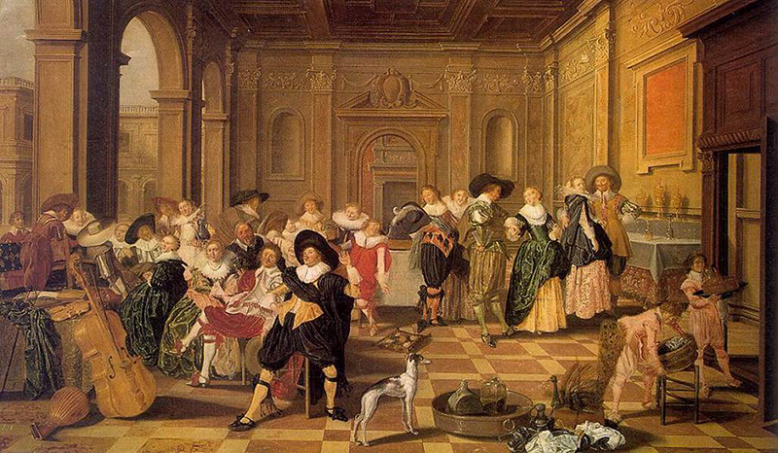
RENAISSANCE, HUMANISM, PROTESTANTISM - AND OPENING TO THE ATLANTIC OCEAN

Slide 2
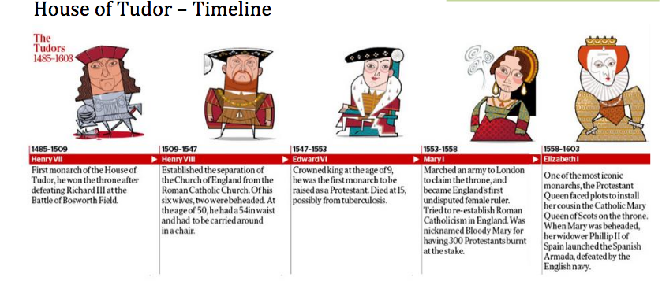

Slide 3
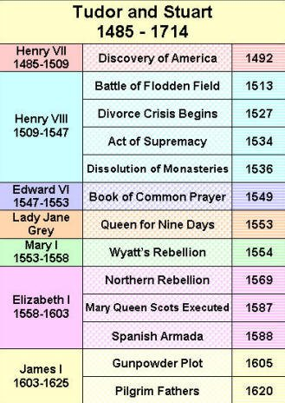
ENGLISH MODERN DYNASTIES
AT A GLANCE…

Slide 4
INTRODUCTION: how to define « Renaissance », « humanism » and « protestantism » notions?
1. Definitions
Renaissance : artistic movement opening the Modern Times, through re-discovery of Antiquity. They want to represent nature as it is, and not as it should be. Imitating nature is one of their major goals.
Humanism: Artists, writers and philosophers consider that mankind shall be placed at the core of the universe instead of God
Protestantism : for Catholics, this is a Christian heresy. As a matter of fact, this is a new Christian religion, coming from catholicism and blaming the Church and the Pope for being corrupted. Martin Luther, who founded this new religious belief, wanted to go back to the roots (=origins) of christianity.
2. Historical context
After the New World was discovered at the end of the 15th c., a new vision of the world and of mankind emerged. At the turning point of the 16th c., under the reign of Henry VII, England was still a Catholic kingdom submitted to the Catholic Church and the Pope. When Henry VIII came to power, he instaured Anglicanism – and things became more complexe on a religious and political point of view…
To what extent can we say that British Modern Times are dominated by Renaissance, Humanism, Reform and opening to the Atlantic ocean ?

Slide 5
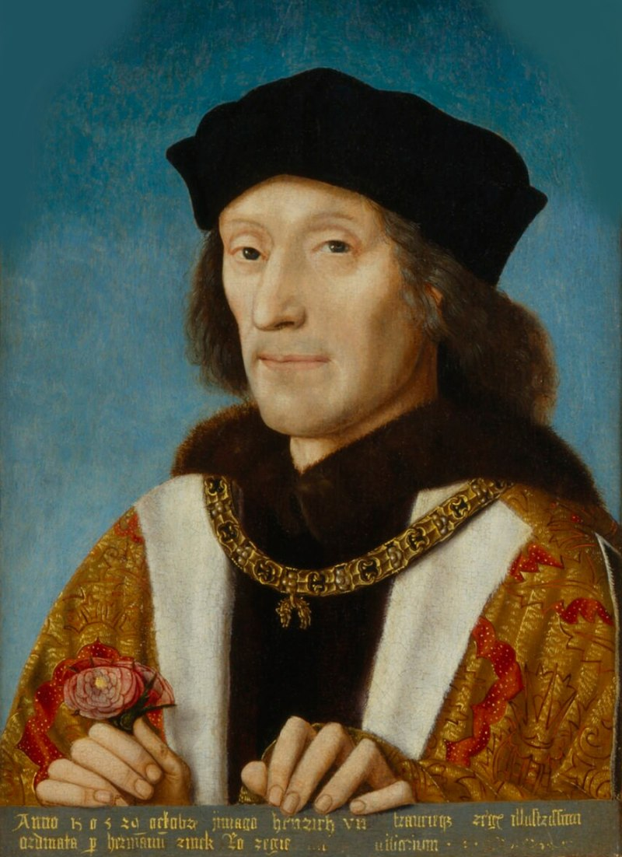
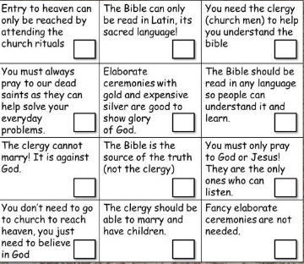
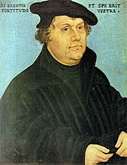
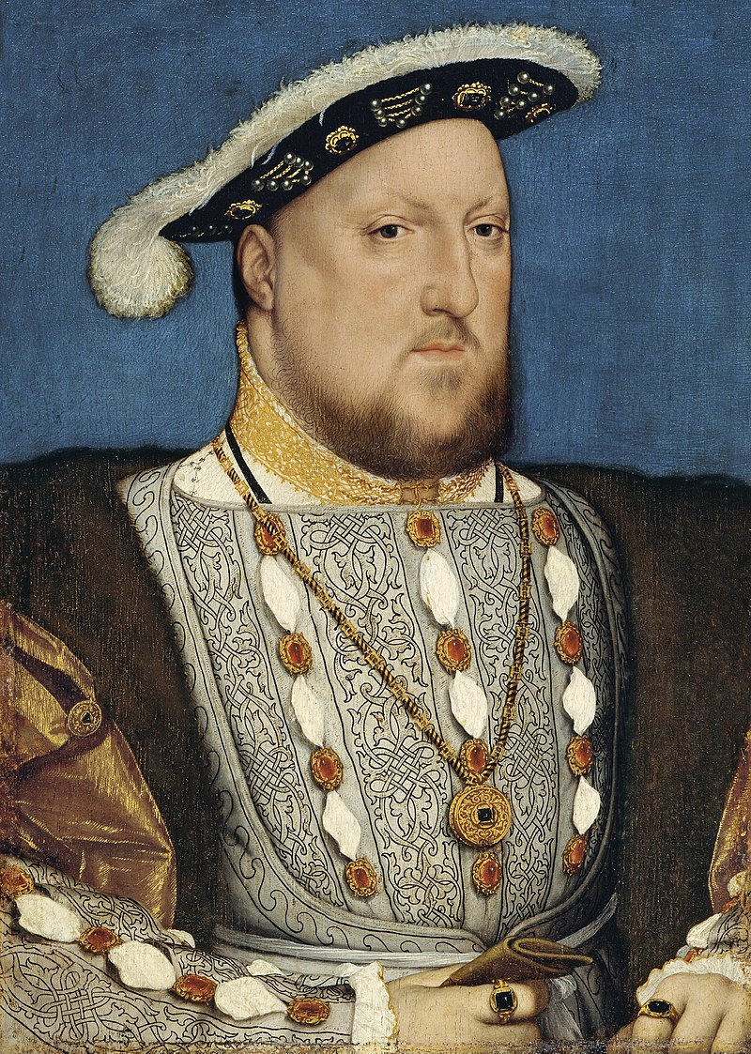
The Tudors and the Church : birth of Anglicanism
Historical context
1. Check your knowledge filling the right boxes with a P. or a C.
Henry VII
P
C
Martin Luther
2. Picking up information from the video, explain the reasons why Henry VIII was proclaimed « Defensor of the Faith »
Henry VIII

Slide 6
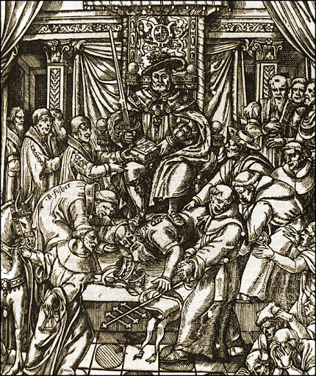
B. Birth of Anglicanism : from the Act of Supremacy to the Dissolution of Monasteries
Doc 1. Act of Supremacy, 1534
Albeit the king's Majesty justly and rightfully is and ought to be the supreme head of the Church of England, and so is recognized by the clergy of this realm in their convocations, yet nevertheless, for corroboration and confirmation thereof, and for increase of virtue in Christ's religion within this realm of England, and to repress and extirpate all errors, heresies, and other enormities and abuses heretofore used in the same, be it enacted, by authority of this present Parliament, that the king, our sovereign lord, his heirs and successors, kings of this realm, shall be taken, accepted, and reputed the only supreme head in earth of the Church of England, called Anglicana Ecclesia; and shall have and enjoy, annexed and united to the imperial crown of this realm, as well the title and style thereof, as all honors, dignities, preeminences, jurisdictions, privileges, authorities, immunities, profits, and commodities to the said dignity of the supreme head of the same Church belonging and appertaining; (…) any usage, foreign land, foreign authority, prescription, or any other thing or things to the contrary hereof notwithstanding.
QUESTIONS - Explain what the Act of Supremacy is :
What are the decisions taken throught this Act?
Why were they taken?

Slide 7
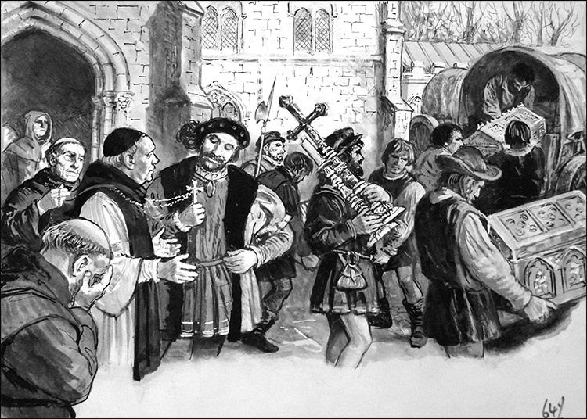
Doc 2. Hugh Arnold-Forster, A History of England (1898)
Some of the monks lived good lives and did good work in teaching and helping the poor... there were others who lived bad lives, and spent their money upon themselves... When Henry made up his mind to destroy the monasteries and nunneries, it was not hard for him to find out many bad things which could truly be said of the monks and nuns, and which he could use as an excuse for taking away their property.
Doc 3. G.W.O. Woodward, The Dissolution Of The Monasteries (1985)
One might think that Henry saw the religious orders as a threat to his newly founded Church of England, having previously been supporters of the papacy. But two years before, all but a very few clerics (Thomas More and John Fisher being notable exceptions) had signed without demur the Act of Supremacy which upheld the validity of the king's marriage to Anne Boleyn and rejected the authority of the Pope who had pronounced against it. Only two orders had offered any resistance to the oath, and had paid the price. The loyalty of' the rest was not in doubt.
This leaves us to draw the conclusion that the prime interest of the government in the Dissolution was, from start to finish, in the money which could be raised. This hypothesis is supported by the fact that income was the criterion for suppression. Simply, any monastery receiving less than £200 a year was closed. The alleged state of the house's morals was quite irrelevant. It was the wealth that mattered.
QUESTIONS
3. Why did Henry VIII decide to close the monasteries ? (doc 3)
4. What arguments were used to justify this choice ? (doc2)

Slide 8
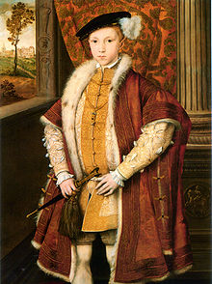
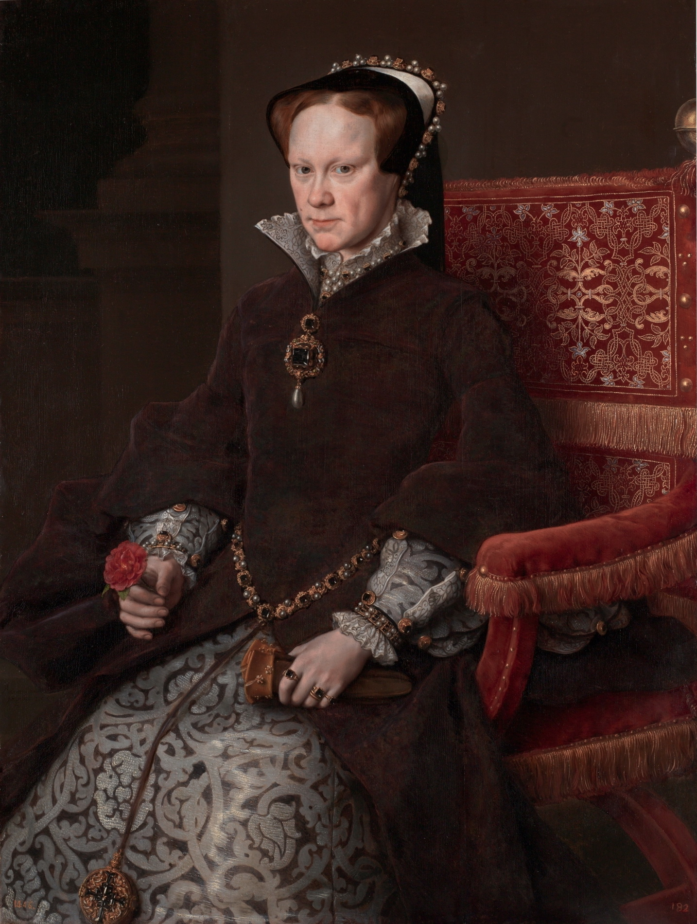
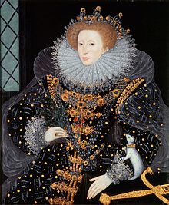
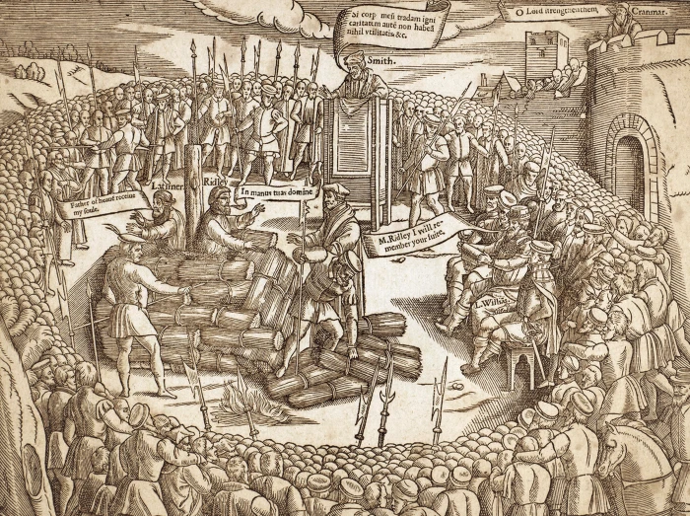
C. Alternatives between Catholicism and Protestantism
Doc 1. Cranmer’s Book of Common Prayer (1549)
The disagreement is testimony to the book's qualities as an attempt at compromise between the Catholic and Protestant positions. Inevitably, both sides disliked it. The abolition of Latin upset conventional English people, and there was too much compromise for the tougher Protestants, especially as the country's staunchest conservative, Bishop Stephen Gardiner of Winchester, announced from his confinement in the Tower of London that the new rites were Catholic enough to be tolerated. This was a red rag to the Protestant bull.
Cranmer produced a new and more radical Protestant prayer book in 1552 (…). It was revised in a more Catholic spirit in 1559, to be succeeded eventually by the 1662 Anglican prayer book, more Catholic still and the familiar one which has lasted down into this century.
www.historytoday.com
QUESTIONS:
What is the main goal of the Book of Common Prayer ? (doc 1)
Why was Mary I nicknamed « Bloody Mary »? (doc 2)
Edward VI
« Bloody Mary »
(Mary I)
Elizabeth I,
the « Virgin Queen »
Doc 2. The 1555 execution of Bishop Nicholas Ridley and Father Hugh Latimer, as depicted in the "Book of Martyrs" by John Foxe.

Slide 9
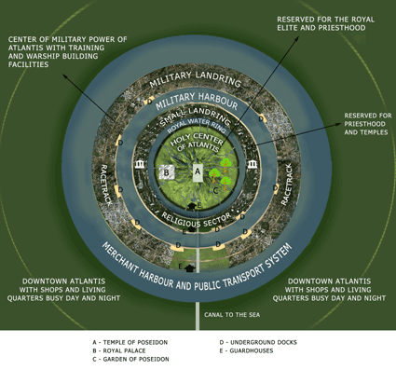
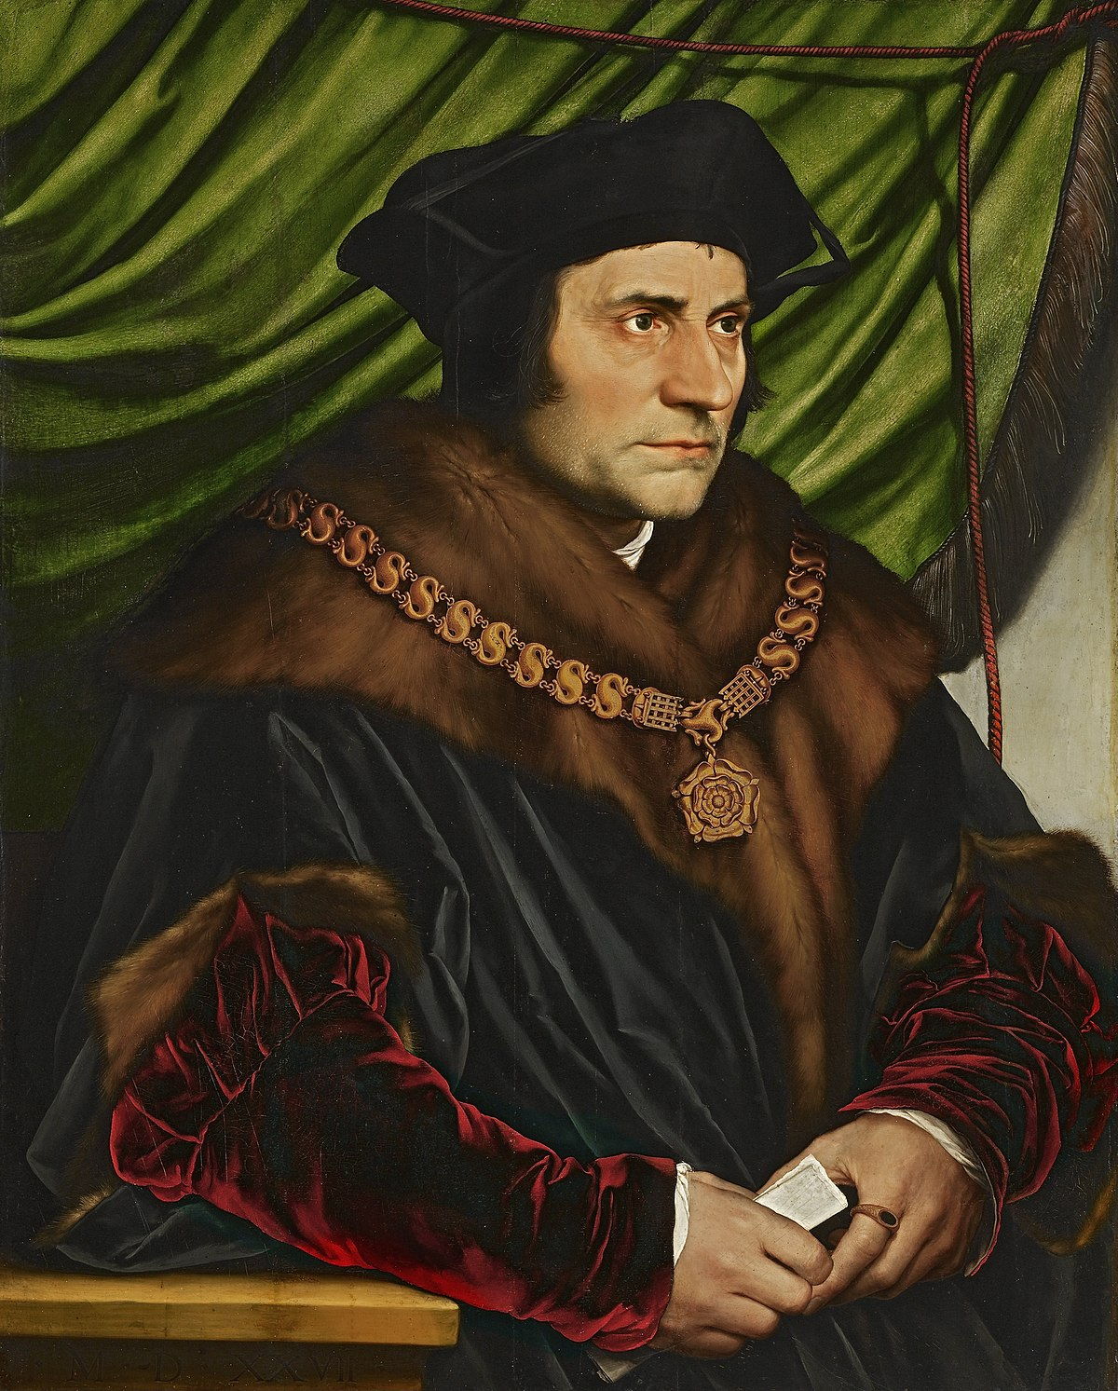
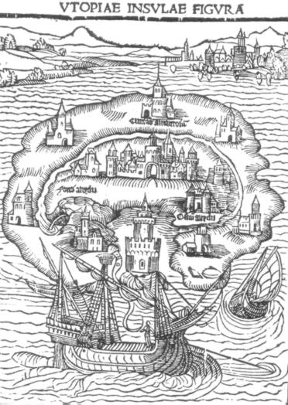
II. Politics and culture during the English Renaissance
Thomas More : a Humanist and a Statesman
… To be compared with Plato’s Atlantis
More’s Utopia Island...
As long as there is any property, and while money is the standard of all other things, I cannot think that a nation can be governed either justly or happily: not justly, because the best things will fall to the share of the worst men; nor happily, because all things will be divided among a few (…), the rest being left to be absolutely miserable. Therefore when I reflect on the wise and good constitution of the Utopians--among whom all things are so well governed, and with so few laws; where virtue hath its due reward, and yet there is such an equality, that every man lives in plenty (…) I grow more favorable to Plato (…) : for so wise a man could not but foresee that the setting all upon a level was the only way to make a nation happy, which cannot be obtained so long as there is property. »
Thomas More, Utopia, Book I, 1516.
QUESTIONS
What is Utopia ? Give some examples taken from the text and the map to answer.
How long can we say that Utopia illustrate Humanist ideas?

Slide 10
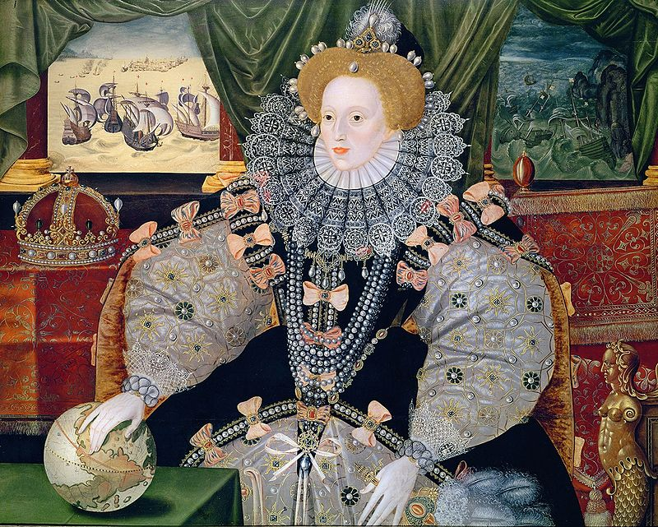
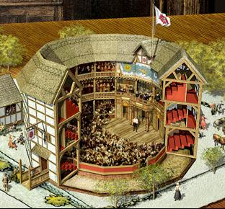
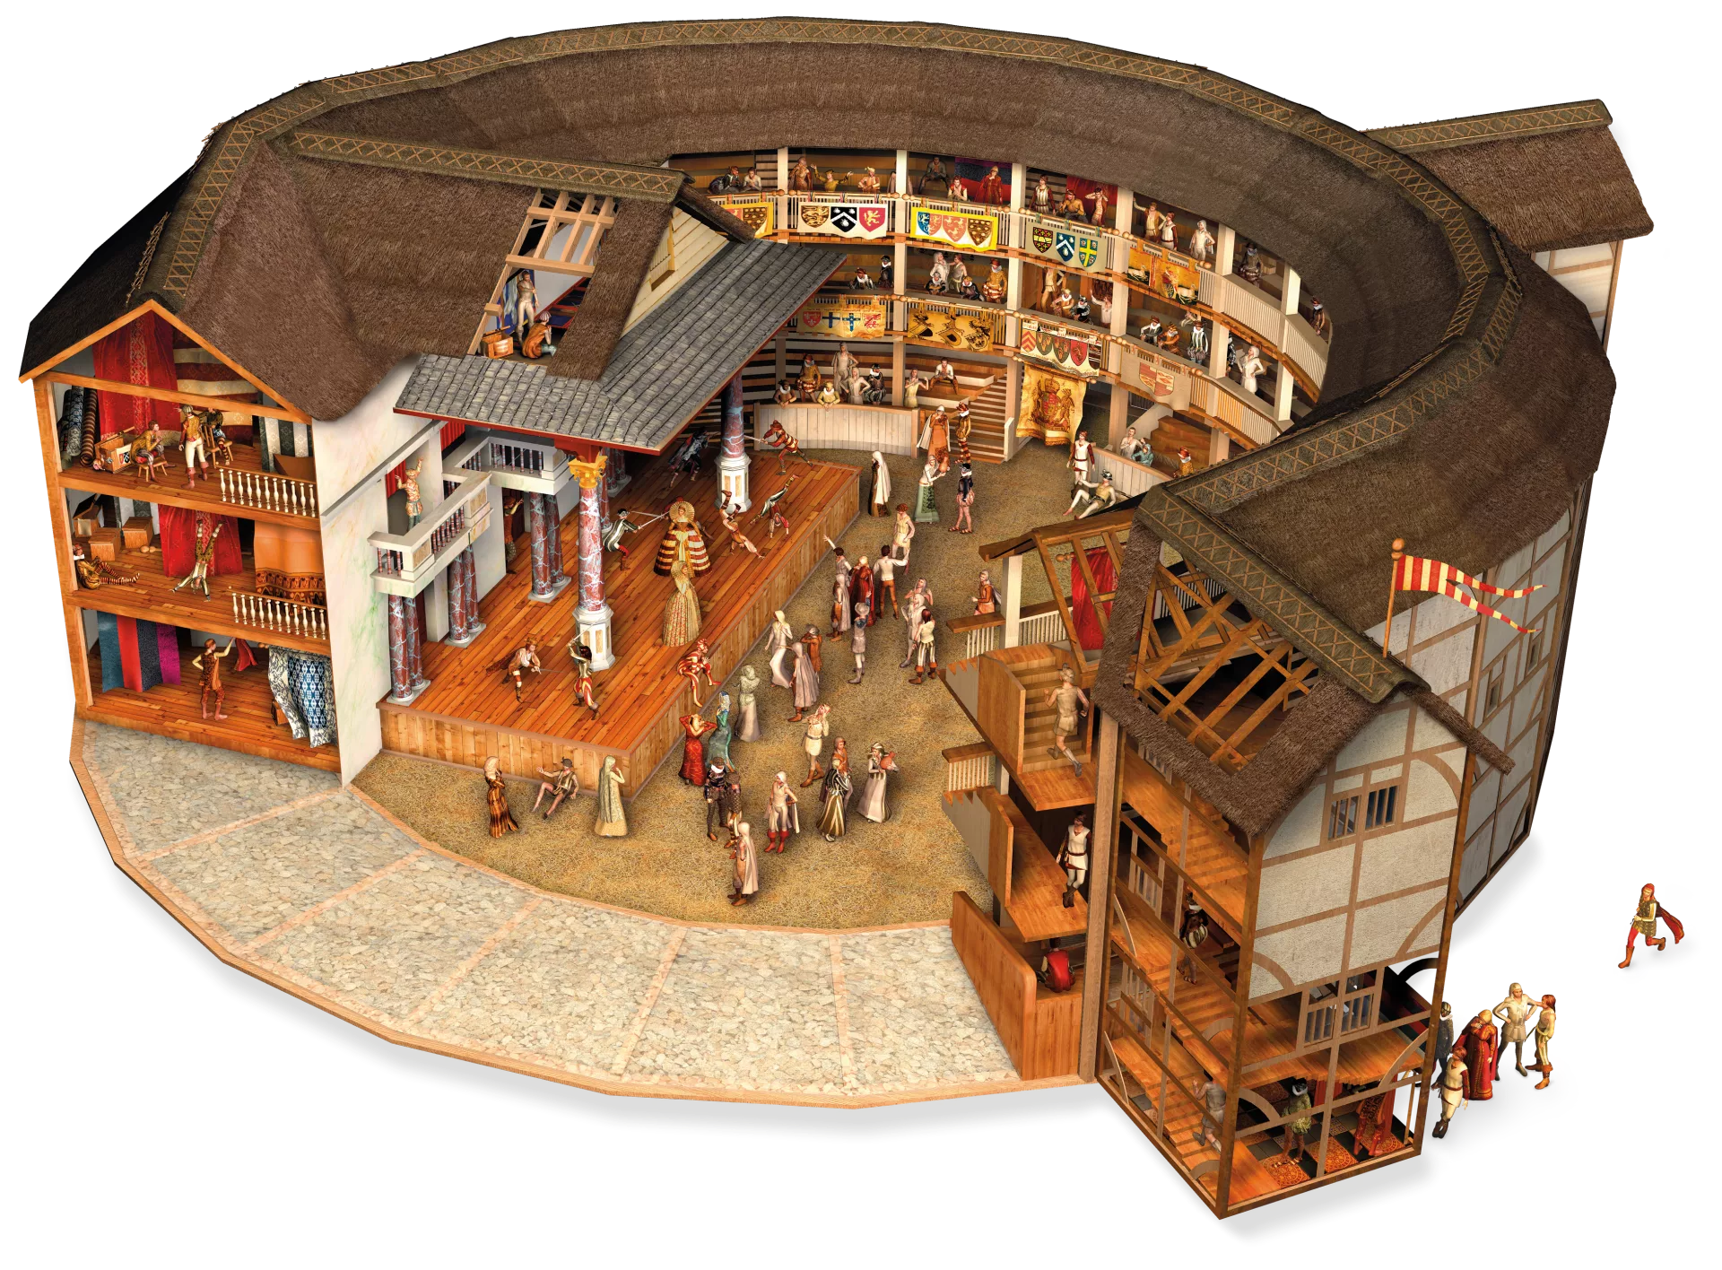
B. Humanism and Renaissance through literature during the Elizabethan era
ON YOUR OWN !
Describe the 1st document in order to underline the main aspects of the Elizabethan politics
Doc 1. The Armada Portrait of Queen Elizabeth I, unknown British artist, 1588
Doc 2. Shall I compare thee to a summer’s day?
(W. Shakespeare - Sonnet 18)
Shall I compare thee to a summer’s day?
Thou art more lovely and more temperate.
Rough winds do shake the darling buds of May,
And summer’s lease hath all too short a date.
Sometime too hot the eye of heaven shines,
And often is his gold complexion dimmed;
And every fair from fair sometime declines,
By chance, or nature’s changing course, untrimmed;
But thy eternal summer shall not fade,
Nor lose possession of that fair thou ow’st,
Nor shall death brag thou wand'rest in his shade,
When in eternal lines to Time thou grow'st.
So long as men can breathe, or eyes can see,
So long lives this, and this gives life to thee.
Two Elizabethan theatres: the Rose (1587) and the Globe (1599)
This sonnet is written in iambic pentameters and may be read in this way: a short, then a long syllable (˘ ¯), fifth times each verse.
Similar verses were composed during Greek Antiquity.

Slide 11
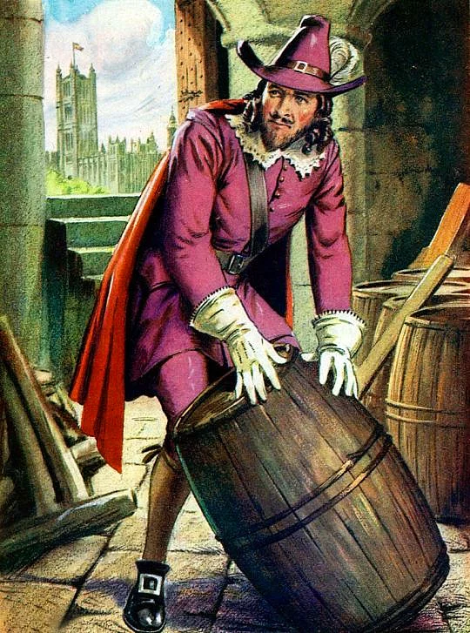
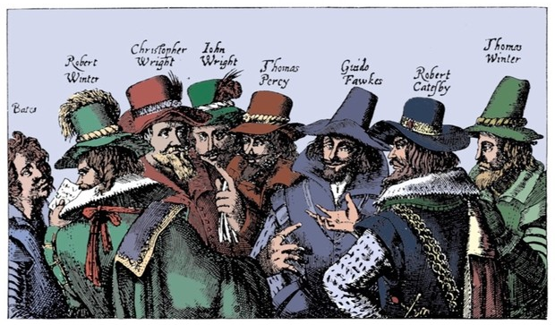
B. Guy Fawkes and the Gunpowder Plot
Using the video, fill the blanks so as to complete this following traditional poem
Remember, remember, the 5th of November
The Gunpowder Treason and plot ;
I know of no reason why Gunpowder Treason
Should ever be forgot.
Guy Fawkes, Guy Fawkes,
'Twas his intent.
To blow up the King and the Parliament.
Three score barrels of powder below.
Poor old England to overthrow.
By God's providence he was catch'd,
With a dark lantern and burning match
Holloa boys, Holloa boys, let the bells ring
Holloa boys, Holloa boys, God save the King!
Hip hip Hoorah !
Hip hip Hoorah !
A penny loaf to feed ol'Pope,
A farthing cheese to choke him.
A pint of beer to rinse it down,
A faggot of sticks to burn him.
Burn him in a tub of tar,'
Burn him like a blazing star.
Burn his body from his head,
Then we'll say: ol'Pope is dead.

Slide 12
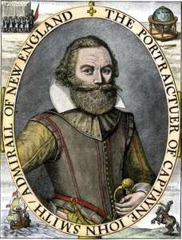
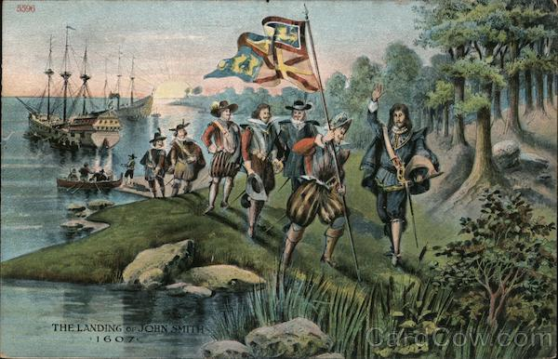
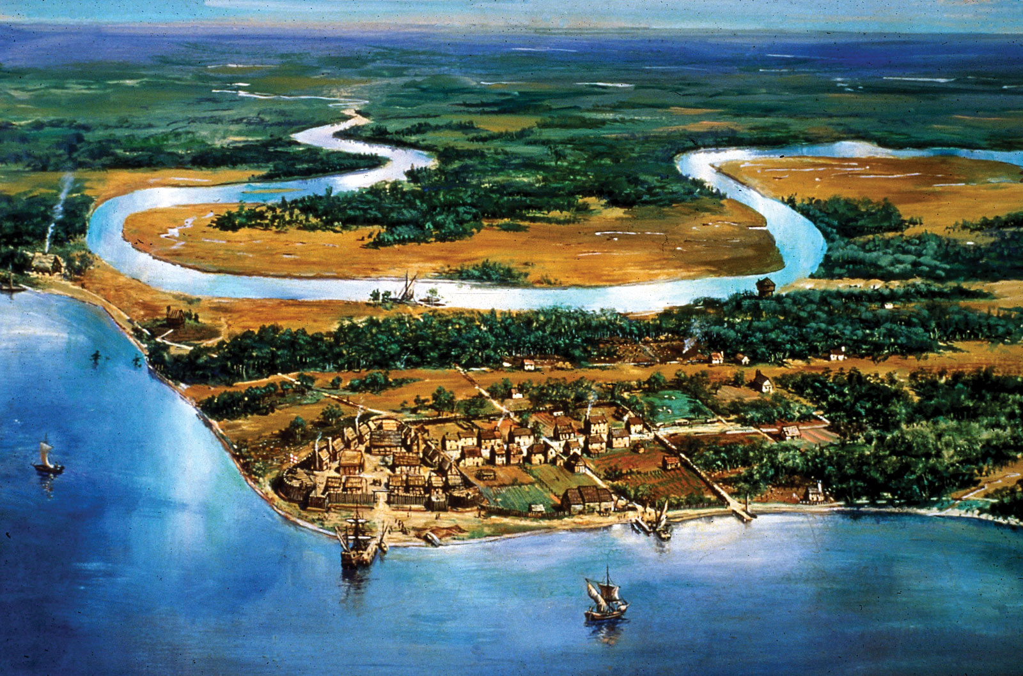
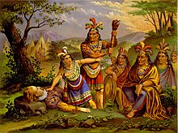
III. Settling in the New World and funding new societies : John Smith of Jamestown and the first American colonies
A. Sailing through the Atlantic ocean to Virginia
Chalk and talk lesson
John Smith, (baptized January 6, 1580, Willoughby, Lincolnshire, England—died June 21, 1631, London), English explorer and early leader of the Jamestown Colony, the first permanent English settlement in North America. Smith played an equally important role as a cartographer and a prolific writer who vividly depicted the natural abundance of the New World, whetting the colonizing appetite of prospective English settlers.
Encyclopaedia Britannica

Slide 13
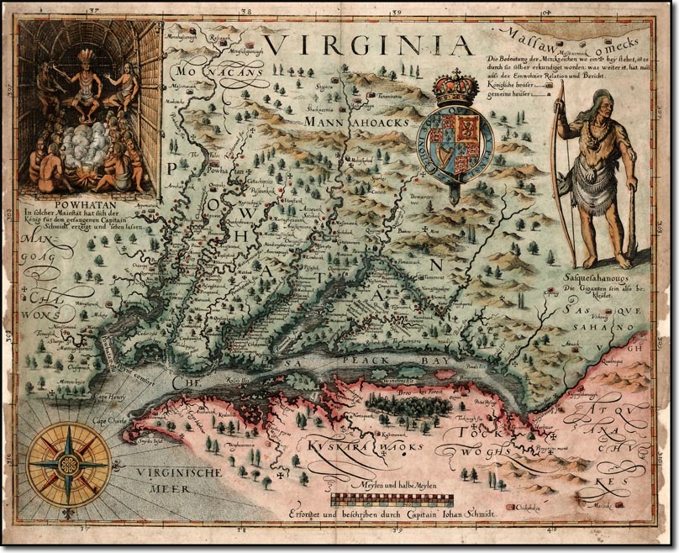
B. Funding the first American colonies
Doc 2. John Smith's map of Virginia was originally printed in 1612. (Image credit: Public domain.)
Doc 1. John Smith in Jamestown
With the arrival of new settlers and the help from the Powhatans, the situation at Jamestown began to slowly improve. At this point, the Virginia Company sent Smith to explore the Chesapeake in search of gold and a passage to the Pacific Ocean. Smith embarked on two lengthy voyages, investigating 2,500 miles of territory. He did not find gold or a route west, but he did acquire food for the colonists, learned about the natives and created highly accurate maps of the area. These maps became one of Smith’s greatest accomplishments and were used by future explorers. (…)
Nevertheless, in September 1608, Smith was elected president of the colony. (…)
Virginia was experiencing a severe drought. The Powhatan community was also short on food, and therefore refused to share with the English for a time. Smith responded to this situation with violence, burning villages, stealing food, imprisoning, beating, and forcing the natives into labor. This violent approach caused further problems for Smith, since Virginia Company officials and other colony leaders wanted to convert the Indians to Christianity.
www.livescience.com
QUESTIONS
Why was John Smith sent to explore new territories?
Were these exploring travels successful?
Describe their relationships with the natives.

Slide 14
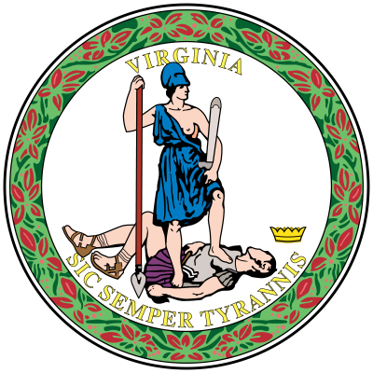
C. The « first seeds of American constitutional values »
Doc 1. The Virginia Charter
« The colonies and the plantations shall enjoy the use of the gold, silver, and copper to be found. They shall give 1/5 of the gold and silver, and 1/15 of the copper to us, our heirs and successors, as well as any profit from this. (…)
The colonists and their deputies, ministers, and traders may transport goods, property, armor, ammunition, and furniture that is needed for their dress and defense in respect of the plantations, out of England and Ireland and all other British holding from time to time (…). The colonists shall have all the lands, woods, soil, grounds, havens, ports, mines, minerals, marshes, waters, fishing, commodities, and inheritable property whatsoever (…). We and our heirs and successors declare that all people born within and inhabit the colonies and plantations shall enjoy all the liberties, franchises, and immunities within any of Britain's other dominions. »
Charter of the Virginia company, signed by King James I on April 10, 1606
QUESTIONS
What is the main topic of the first Charter?
What specific rights were guaranteed by the king through these two charters?
Doc 2. The first legislative assembly on the American continent
« Indeed, one of the major grievances of our ancestors at the dawn of the Revolution was that England failed to grant the colonists the same rights as those enjoyed by the citizens residing in the mother country. In these simple words -- buried in a document concerned mostly with the rights of the proprietors -- lay the real authority for the first legislative assembly on the American continent to take place. (…)
The second trend was that the power to make laws regulating the colony was becoming more and more decentralized. In 1609 the King, unwilling to shoulder the financial burden of the colony from the royal treasury, signed a second charter which allowed for the sale of company stocks to the public. James I thereby reluctantly surrendered his absolute control over the colony in an effort to solicit the support of as many investors as possible. This trend towards decentralization of power did not, at first, result in greater rights and privileges for the colonists. »
https://www.nps.gov/jame/learn/historyculture/the-first-legislative-assembly.htm

Slide 15
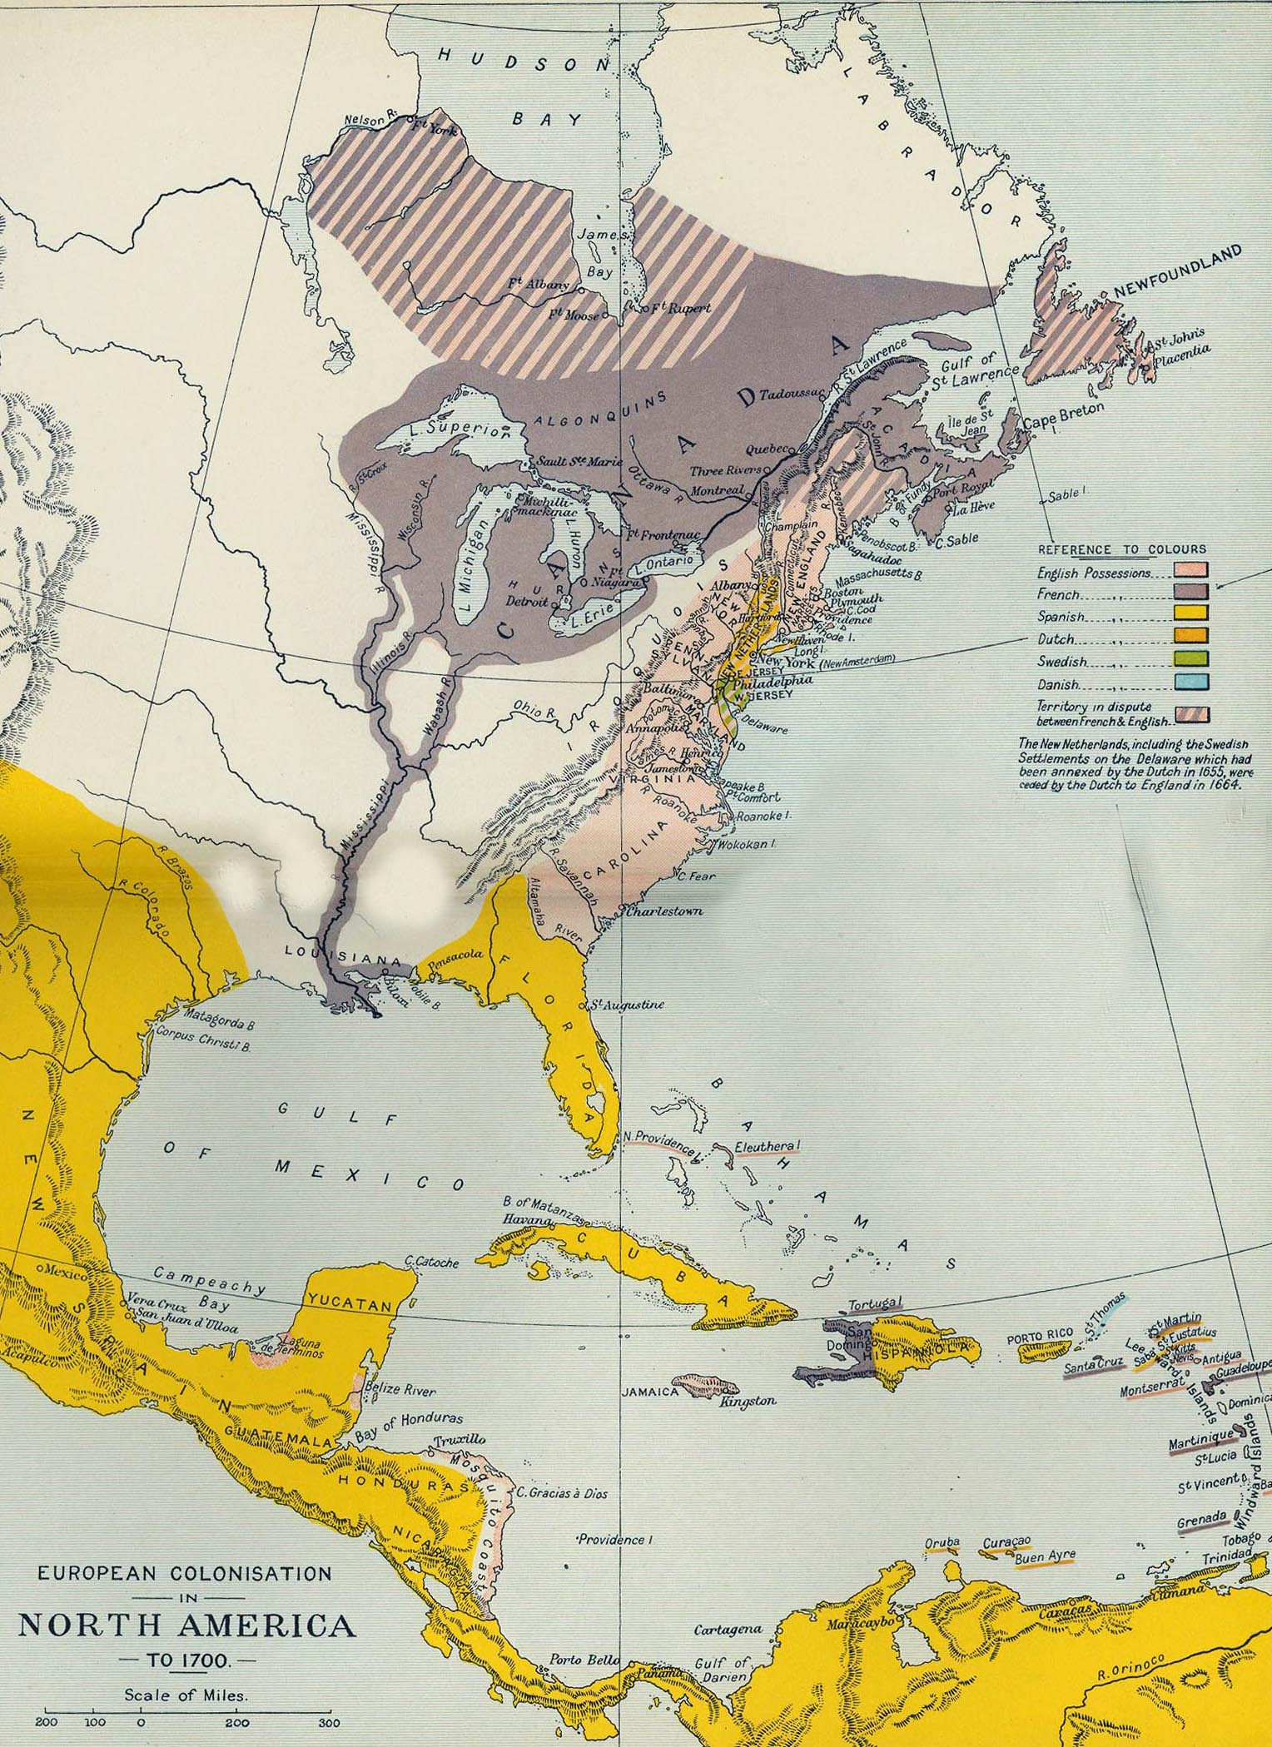

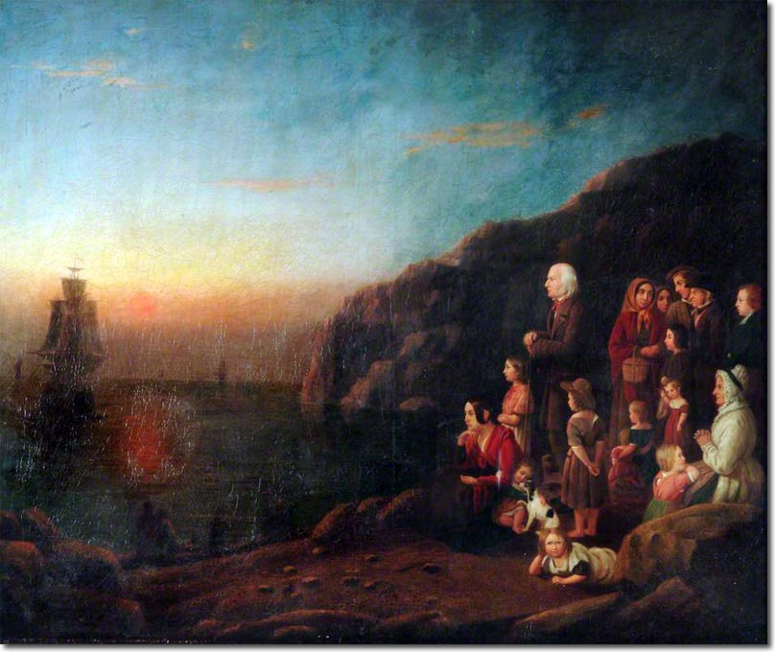
CONCLUSION: Establishment and expansion of the British power overseas in the 17th c.

