Slide 1

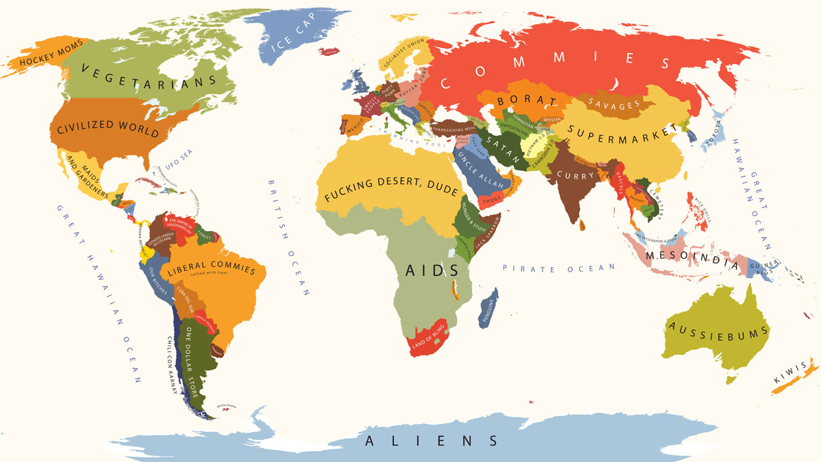
THE USA AND THE WORLD FROM 1945 TO 2003

Slide 2
To what extent can we consider that the American foreign policy has been dominated by interventionism theories since the end of WWII ?
How have the notions of leadership and power evolved in the American foreign policy since 1945 ?
John Gast - "American Progress," (1872)

Slide 3
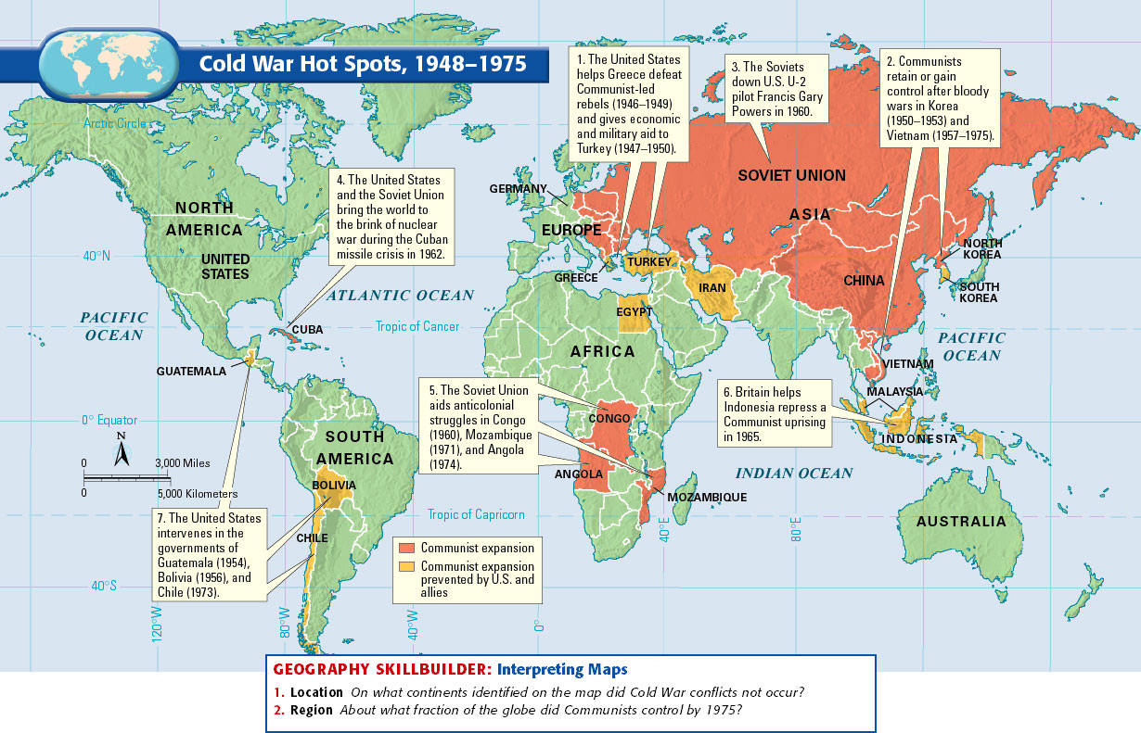

Slide 4
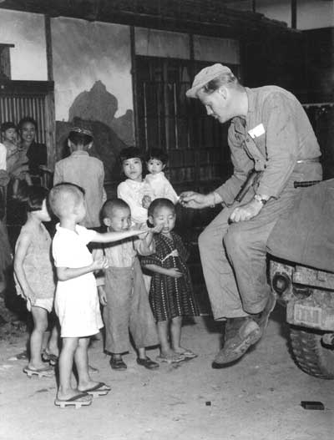
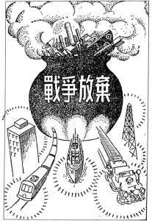
I. The USA as the leader of the Free World (1945-1950s)
A. Occupation and reconstruction of Japan (1945-1952)
Between 1945 and 1952, the U.S. occupying forces, led by General Douglas A. MacArthur, enacted widespread military, political, economic, and social reforms. (…)
In the Potsdam Declaration, they called for Japan’s unconditional surrender; by August of 1945, that objective had been achieved. In September, 1945, General Douglas MacArthur took charge of the Supreme Command of Allied Powers (SCAP) and began the work of rebuilding Japan. (…)
The first phase, roughly from the end of the war in 1945 through 1947, involved the most fundamental changes for the Japanese Government and society. The Allies punished Japan for its past militarism and expansion by convening war crimes trials in Tokyo. At the same time, SCAP dismantled the Japanese Army and banned former military officers from taking roles of political leadership in the new government.
In the economic field, SCAP introduced land reform, designed to benefit the majority tenant farmers and reduce the power of rich landowners, many of whom had advocated for war and supported Japanese expansionism in the 1930s. MacArthur also tried to break up the large Japanese business conglomerates, or zaibatsu, as part of the effort to transform the economy into a free market capitalist system.
In 1947, Allied advisors essentially dictated a new constitution to Japan’s leaders. Some of the most profound changes in the document included downgrading the emperor’s status to that of a figurehead without political control and placing more power in the parliamentary system, promoting greater rights and privileges for women, and renouncing the right to wage war, which involved eliminating all non-defensive armed forces.
Japanese children, seeing a Marine for the first time,
eagerly reach or chocolates offered them by SSgt Henry
A. Weaver, III. National Archives Photo 127-N-139887
Drawing from a booklet, The Story of the New Constitution, issued by the Ministry of Education in 1947, and used in a middle-school text to illustrate the “renunciation of war.” Reproduced and discussed in John Dower, Embracing Defeat, p. 399.

Slide 5
Why was Japan occupied by the USA ?
How did this military occupation happen?
What were the political (economic) consequences ?

Slide 6
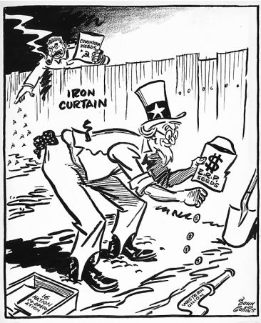
B. « Dollar diplomacy »: Bretton Woods agreements and Marshall Plan
Document 2 : The Marshall Plan
Document 1 : Bretton Woods Agreements
Bretton Woods refers to the international monetary system adopted in July 1944 that established rules for rebuilding the postwar economic order. Though World War II was not yet over, 730 delegates from 44 Allied nations attended the conference at the Mount Washington Hotel in Bretton Woods, N.H., to create a new monetary structure governing the financial and commercial relations among the world’s leading economies. The goal was to avert a replay of the economic disasters of the 1930s. (…)
Some delegates grumbled that the United States was using its new superpower status to push its own interests — like global free trade — and that it was slow to compromise. At one point, the British representative, the economist John Maynard Keynes, wrote that the Americans “plainly intend to force their own conceptions through, regardless of the rest of us.” (The Soviet Union was at the conference but refused to join the I.M.F.) (…)
Two organizations were set up to help govern the international monetary system: the International Monetary Fund, which would address temporary imbalances of payments, and the International Bank for Reconstruction and Development, which is now the chief agency of the World Bank Group.
« Bretton Woods System », www.nytimes.com
Weeds : les mauvaises herbes
Iron curtain : rideau de fer
ERP seeds : graines de l’European Recovery Program (programme de reconstruction européen)
16 nations cooperation : coopération des 16 nations
Western union : union de l’Occident

Slide 7
What are the economic consequences of the US intervention in Europe?
How do they manage to settle their power (in Europe + world) ?
Harry Dexter White : « absence of a high degree of economic collaboration among the leading nations would inevitably result in economic warfare that would be just the prelude and instigator of military warfare on an even vaster scale ».
Soft power (Joseph Nye, 1980s)

Slide 8
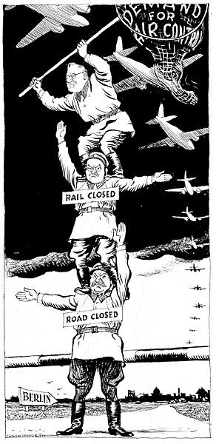
C. Truman policy: Berlin and Korea
Document 1 : Truman Address on Korea (July 19, 1950)
On Sunday, June 25th, Communist forces attacked the Republic of Korea.
This attack has made it clear, beyond all doubt, that the international Communist movement is willing to use armed invasion to conquer independent nations. An act of aggression such as this creates a very real danger to the security of all free nations. The attack upon Korea was an outright breach of the peace and a violation of the Charter of the United Nations. By their actions in Korea, Communist leaders have demonstrated their contempt for the basic moral principles on which the United Nations is founded. This is a direct challenge to the efforts of the free nations to build the kind of world in which men can live in freedom and peace. (…). These actions by the United Nations and its members are of great importance. The free nations have now made it clear that lawless aggression will be met with force. The free nations have learned the fateful lesson of the 1930's. That lesson is that aggression must be met firmly. Appeasement leads only to further aggression and ultimately to war. The principal effort to help the Koreans preserve their independence, and to help the United Nations restore peace, has been made by the United States. We have sent land, sea, and air forces to assist in these operations. We have done this because we know that what is at stake here is nothing less than our own national security and the peace of the world.
Paul F. Boller, Jr. and Ronald Story, A More Perfect Union: Documents in U.S. History, Volume II. ©1984 by Houghton Mifflin Company.
Document 2 : « No go, Joe ! », the Berlin blockade seen by Leslie Gilbert Illingworth (27 september 1948)

Slide 9
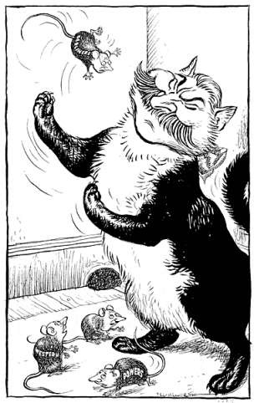
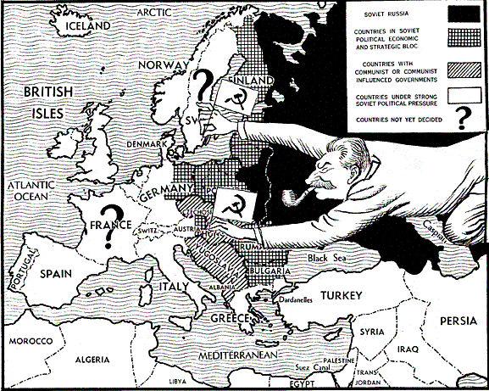
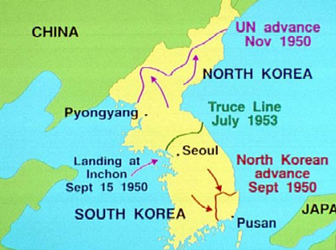
British caricature on the first Berlin Crisis, by Illingworth – Daily Mail, 9 september 1948
Soviet take over in Europe, seen from the USA (www.johndclare.net)

Slide 10
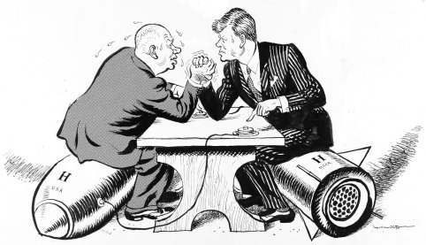
II. The USA from the 1950s to the 1970s
A. Kennedy policy: Cuba and Berlin
Document 1 : The Cuban Missile Crisis (caricature by Leslie G. Illingworth published in the Daily Mail, October 29, 1962)
- OK, Mr. President, let’s talk.
Document 2 : The Second Berlin Crisis seen by J. F. Kennedy
The immediate threat to free men is in West Berlin. But that isolated outpost is not an isolated problem. The threat is worldwide. Our effort must be equally wide and strong, and not be obsessed by any single manufactured crisis (…). If anyone doubts the extent to which our presence is desired by the people of West Berlin, compared to East German feelings about their regime, we are ready to have that question submitted to a free vote in Berlin and, if possible, among all the German people. And let us hear at that time from the two and one-half million refugees who have fled the Communist regime in East Germany--voting for Western-type freedom with their feet. (…)
The choice of peace or war is largely theirs, not ours. It is the Soviets who have stirred up this crisis. It is they who are trying to force a change. It is they who have opposed free elections. It is they who have rejected an all-German peace treaty, and the rulings of international law. (…)
Now, in the thermonuclear age, any misjudgment on either side about the intentions of the other could rain more devastation in several hours than has been wrought in all the wars of human history. Therefore I, as President and Commander-in-Chief, and all of us as Americans, are moving through serious days. I shall bear this responsibility under our Constitution for the next three and one-half .years. (…) The Communists control over a billion people, and they recognize that if we should falter, their success would be imminent.
Speech delivered by President J. F. Kennedy, The White Hall, July 25, 1961

Slide 11
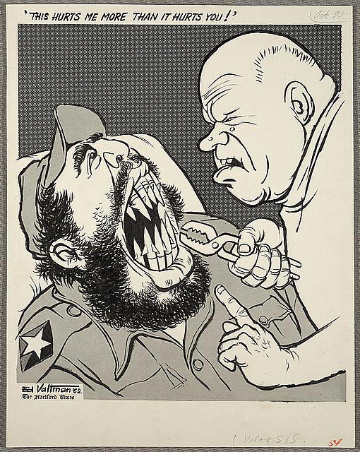
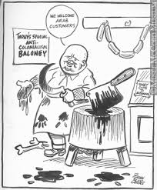
Dr. Khrushchev initiating a Détente with the USA, by Valtman (1962)…
… and as the butcher of Budapest in 1956 !

Slide 12
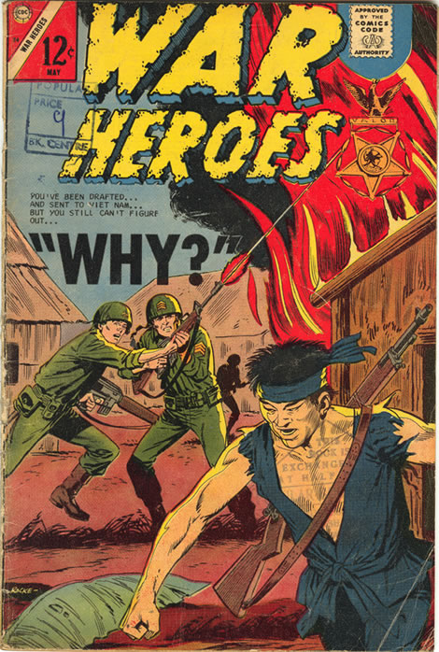
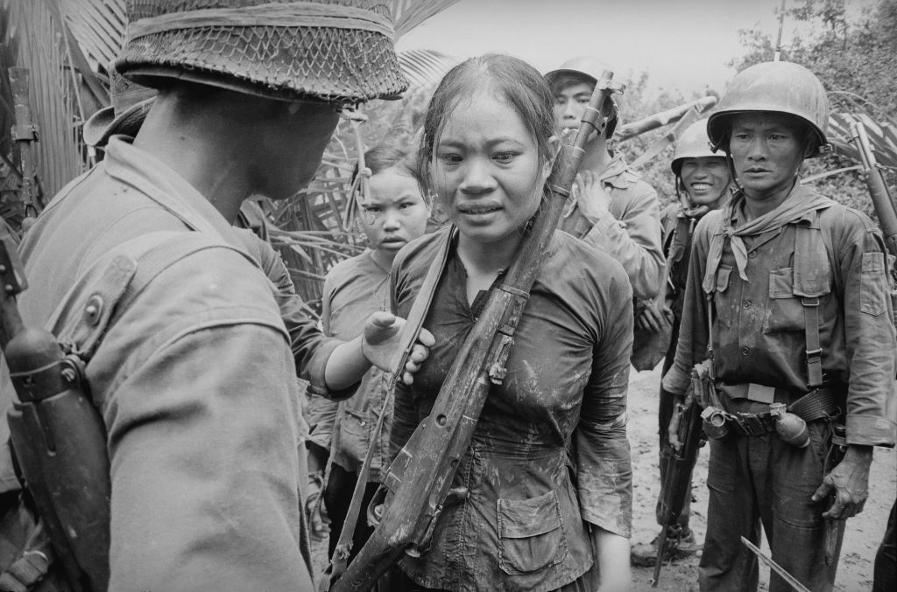
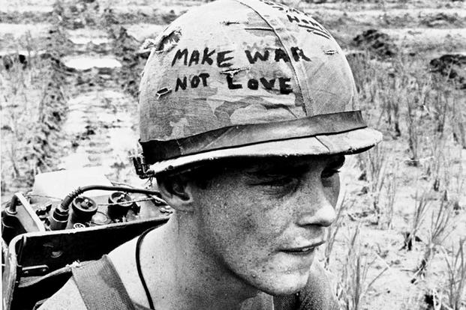
C. Vietnam war (1963-1975): time for doubts
Press photos on Vietnam war
Cover of a mass-market war comic book published by Charlton Comics in May 1967

Slide 13
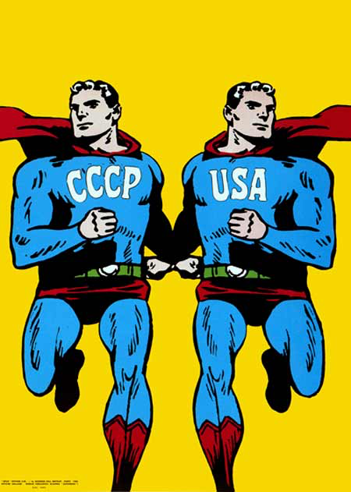
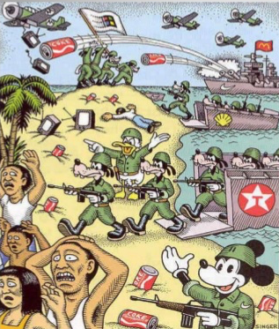
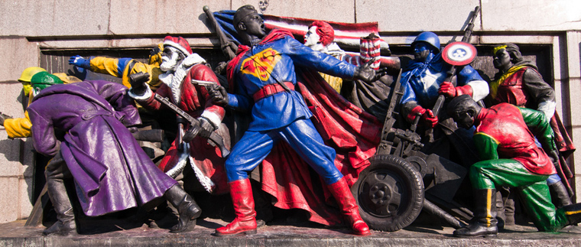
C. The American soft power: films, ads and comics

Slide 14
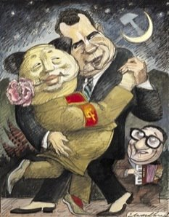
Document 2: Nixon and Mao: The week that changed the world, by Margaret Macmillan

Slide 15
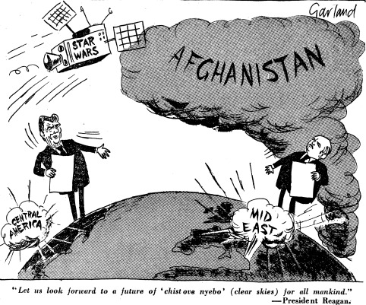
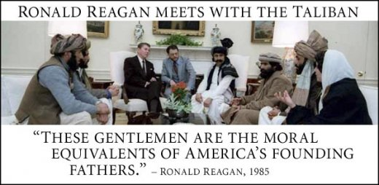
III. From the decline of the USSR to a new balance of powers (1980s-2000)
A. « America is back! »: Reagan policy
Document 1: Reagan and Gorbachev during the Afghan War, by Nicholas Garland, Daily Telegraph, 03 Jan 1986
The Court
N° 1 Decides that in adjudicating the dispute brought before it by the Application filed by the Republic of Nicaragua on 9 April 1984, the Court is required to apply the "multilateral treaty reservation » (…);
N° 2 Rejects the justification of collective self-defence maintained by the United States of America in connection with the military and paramilitary activities in and against Nicaragua the subject of this case;
N° 3 Decides that the United States of America, by training, arming, equipping, financing and supplying the contra forces or otherwise encouraging, supporting and aiding military and paramilitary activities in and against Nicaragua, has acted, against the Republic of Nicaragua, in breach of its obligation under customary international law not to intervene in the affairs of another State […]
N°6 Decides that, by laying mines in the internal or territorial waters of the Republic of Nicaragua during the first months of 1984, the United States of America has acted, against the Republic of Nicaragua, in breach of its obligations under customary international law not to use force against another State, not to intervene in its affairs, not to violate its sovereignty and not to interrupt peaceful maritime commerce
The Republic of Nicaragua v. The United States of America (June 27, 1986), public international law case decided by the International Court of Justice (ICJ)

Slide 16
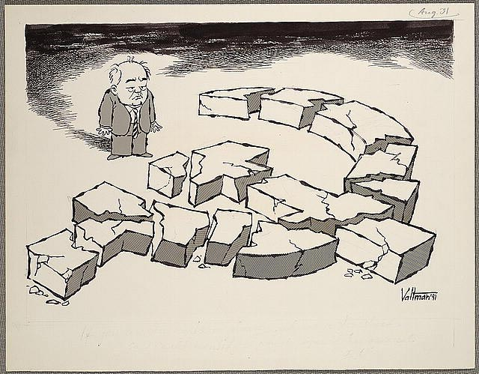
Document 1: The end of USSR by Fred Valtman (1991)

Slide 17
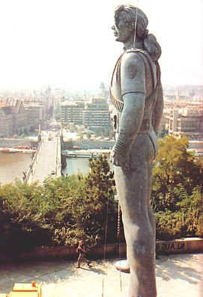
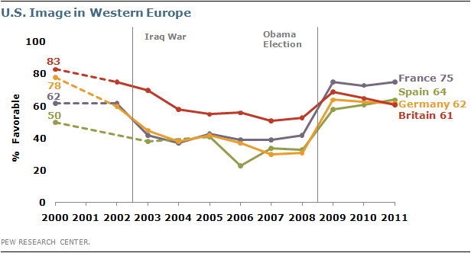
B. Another new world order: US hyperpower in the world
Document 1: A Humanitarian Imperialism, according to Chomsky
As the Cold War ended, new pretexts had to be devised. George Bush celebrated the fall of the Berlin Wall by invading Panama, installing the regime of a tiny minority of bankers and narcotraffickers who, as predicted, have turned Panama into the second most active center for cocaine money laundering in the Western Hemisphere, the State Department concedes, the United States still holding first place. The Red Menace having disappeared, he was protecting us from Hispanic narcotraffickers led by the arch-demon Noriega, transmuted from valued friend to reincarnation of Attila the Hun, in standard fashion, when he began to disobey orders. And we were soon to learn that in the Middle East, long the major target of our intervention forces, the "threats to our interests . . . could not be laid at the Kremlin's door" (Bush National Security Strategy Report, March 1990); after decades of deception, the Soviet pretext can no longer be dredged up to justify traditional Pentagon-based industrial policy and intervention forces (…). Elliott Abrams noted that for the first time, the United States could intervene without concern for a Soviet reaction anywhere.
Noam Chomsky, « Humanitarian Intervention » in Boston Review, December, 1993-January, 1994
Document 2: Evolution of US Image in Western Europe from 2000 to 2011
Document 3: Michael Jackson’s statue in Prague in 1996, where a statue of Lenin used to be settled…

Slide 18
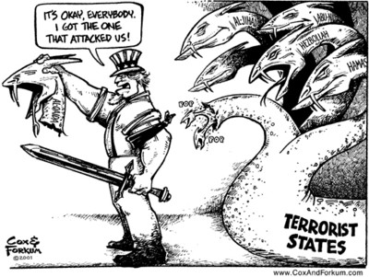
C. 9/11 attacks and retaliation
Document 1: War on terror, Cox and Forkum, 2001
Document 2: “Winning the war on terror”
The American flag flies again over our embassy in Kabul. Terrorists who once occupied Afghanistan now occupy cells at Guantanamo Bay. And terrorist leaders who urged followers to sacrifice their lives are running for their own. America and Afghanistan are now allies against terror. We'll be partners in rebuilding that country […].
Our progress is a tribute to the spirit of the Afghan people, to the resolve of our coalition, and to the might of the United States military. When I called our troops into action, I did so with complete confidence in their courage and skill. And tonight, thanks to them, we are winning the war on terror. The man and women of our Armed Forces have delivered a message now clear to every enemy of the United States: Even 7,000 miles away, across oceans and continents, on mountaintops and in caves -- you will not escape the justice of this nation.
For many Americans, these four months have brought sorrow, and pain that will never completely go away. Every day a retired firefighter returns to Ground Zero, to feel closer to his two sons who died there. At a memorial in New York, a little boy left his football with a note for his lost father: Dear Daddy, please take this to heaven. I don't want to play football until I can play with you again someday.
George W. Bush, State of the Union Address, January 29th, 2002

Slide 19
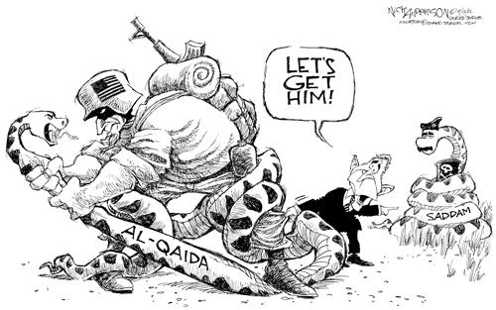
Document 1: War on terror or mass distraction? by Nick Anderson, 2002
Document 2: Axis of Evil: “the Bush vision versus the End of History”
This process does not comport well with Francis Fukayama's vision of the new peaceful, democratic order that would follow the death of the Soviet Union and triumph of capitalism.
Fukayama […] failed to recognize that without the Soviet Union's "containment" the United States would be freer to use force in serving its transnationals, forcing Third World countries to join the "free trade" nexus, and preventing them from serving the needs of their citizens (as opposed to the needs of the transnational corporate community). […]
What can be more frightening and dangerous to the world than facing the Washington Axis of Evil as the overwhelmingly dominant holder of "weapons of mass destruction," which it is seeking to improve and make more usable, with the elite's longstanding arrogance and self-righteousness at an all-time high, and with no countervailing force in sight? Bin Laden's threat is nothing by comparison.
What is more, the Bin Laden threat flows from U.S. actions, which played a crucial role in building up the Al-Qaeda network, and policies which have made a hell of the Middle East and polarized incomes and wealth across the globe. The cycle of violence will only be broken if the Washington Axis of Evil is defeated, removed from office, and replaced by a regime that aims to serve a broader constituency than oil, the MIC, the other transnationals, and the Christian Right.
Professor Edward S. Herman, Z Magazine

Slide 20
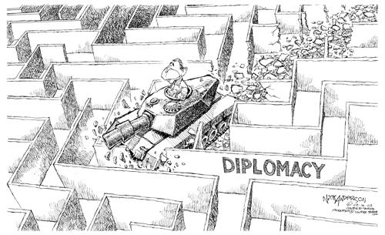
“Diplomacy according to W. Junior”, caricature by Nick Anderson, 9 March 2003

