Slide 1

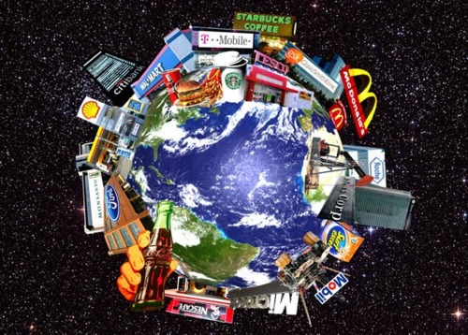
TERRITORIAL STRATEGIES OF THE TNCs
« The same thing, the same way, everywhere » (S. Levitt)

Slide 2
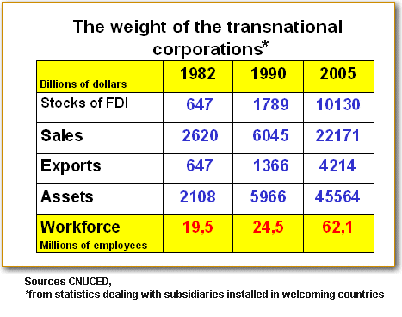
- To what extent can we say that British Petroleum illustrate the territorial strategies of the TNCs on various scales ?
- What kind of specific strategies do they adopt in the global economic system ?

Slide 3

I. Case study on British Petroleum
A. The company’s worldwide marketing strategy
BP’s Global Marketing Multinational corporations operating in complex and diverse political, economic, social and cultural environments have to improve, adjust and develop their marketing strategies on a regular basis. Changing environmental factors create new conditions for their operating, which often require considerable and serious changes in strategic decision-making and positioning of companies. Inflexible and rigid firms will cease to be competitive in the market every time changes occur. (…)
It is difficult to offer customers a point of difference with fuels. However, BP does so by selling petrol and diesel that is better for the environment (…). BP‘s network of service stations is a vital strength in marketing strategy – we have some of the best locations for the service they provide. And research shows customers mainly choose fuel retailers based on their location. They have a significant investment in ensuring right number and quality of locations for our customers (…). Research shows that customers respond well to our promotion campaigns, such as the AA Rewards programme. Our loyalty programmes are a valuable point of differentiation; we use them to drive sales volumes and counter our competitors‘ activity.
www.bp.com

Slide 4
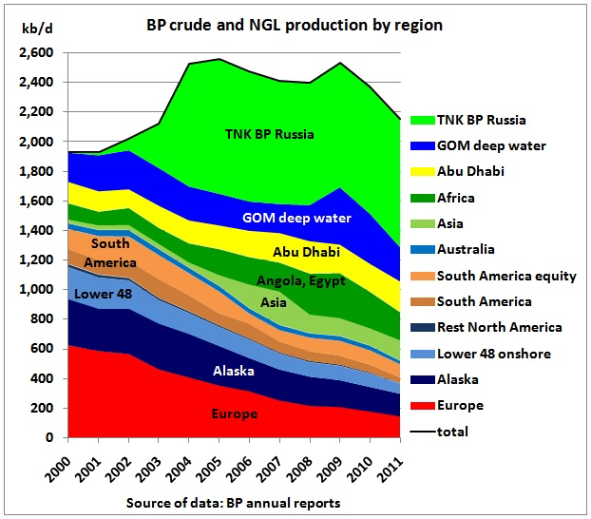
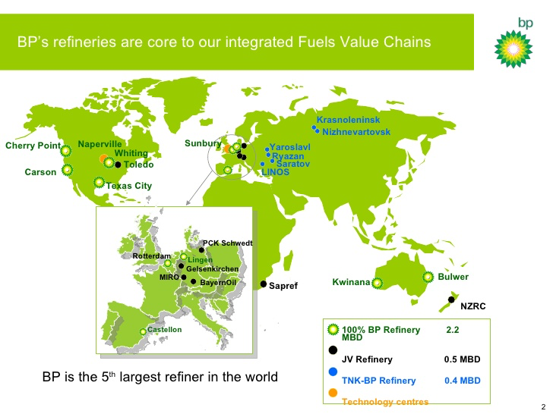
B. The advantages of the « International Division of Labour »
In early 2016, in partnership with Level Up Village, a social impact company, based in the US, Masoom piloted the concept of a mobile bus to deliver science & technology curricula called ‘Tech on Wheels’. (…)
In 2016, BP began working with Masoom, to deliver the second ‘Tech on Wheels’ bus. The bus will house a computer lab that can accommodate as many as 28 students, 2 trainers and a library section with reference material. Travelling from school to school, where the students will use the facility to learn computer skills, build some employable skills, as well as to learn to use digital research material on the web, it will reach almost 400 students across the selected night schools and play a role in enrolling at least 300 out of school children. Between 6.30 pm to 9.30 pm with 3-hour sessions per day, each batch will use the facility to learn computer skills, build some employable skills, as well as learn to use digital research material on the web.
The BP Tech on Wheels bus was launched on June 16, 2017 in Mumbai, India.
« Shine a light ! », www.bp.com
Notes:
What different advantages can the IDW represent for BP?
What about the advantages represented by BP for the countries in which it is settled?

Slide 5
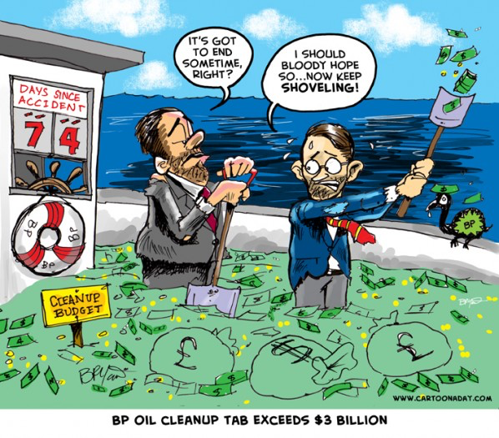

C. Controversies about BP
Document 1:BP Oil Spill Cleanup Cost Exceeds 3 billion, by Bryant Arnold July 5, 2010, www.cartoonaday.com
Document 2: The role played by BP in War for Oil
BP has been accused of taking a "stranglehold" on the Iraqi economy after the Baghdad government agreed to pay the British firm even when oil is not being produced by the Rumaila field, confidential documents reveal. […]
"Iraq's oil auctions were portrayed as a model of transparency and a negotiating victory for the Iraqi government," said Greg Muttitt, author of Fuel on the Fire: Oil and Politics in Occupied Iraq. "Now we see the reality was the opposite: a backroom deal that gave BP a stranglehold on the Iraqi economy, and even influence over the decisions of Opec." […]
Section 12.5 of this revised technical service contract shows that BP and its Chinese partner CNPC can obtain payments for "government imposed curtailment" – which could cover quota demands made on Iraq by Opec. This also applies to disruption to the transport of oil – "curtailments of transporter to receive net production at the transfer point through no fault of the contractor or operator". […]
The changes are likely to anger internal critics of the Baghdad regime, many of whom were suspicious of the original deal. It will also increase the prejudice of those who saw the UK's involvement in toppling Saddam as part of a "war for oil". […]
Terry Macalister, “New terms mean company will be paid even when production is disrupted, critics claim”, The Observer, 31 July 2011.

Slide 6
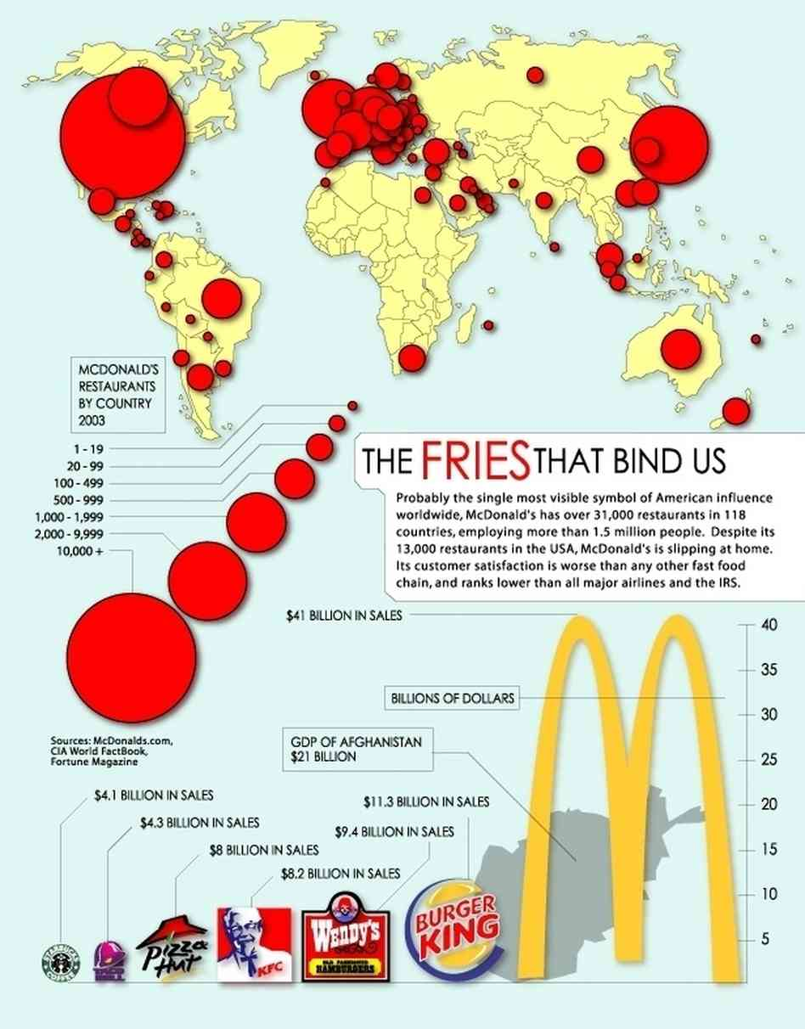
II. Different sorts of territorial strategies and actions
A. Meeting consumers needs everywhere in the world
Document 2: The establishment of MacDonald’s in the world (birth of a new global culture – “main stream”)
Document 1: Expansion of fast food brands in the world
Attitudes have made Vietnam attractive for American fast-food brands (…). The latest entrant is McDonald’s, the fast-food giant, which has restaurants in more than 100 countries and will open its first Vietnam location on Saturday in downtown Ho Chi Minh City. Vietnam has a surging middle class, and most of its 90 million citizens were born after the Vietnam War ended, in 1975. (…)
KFC opened in Vietnam in 1997, two years after the country normalized relations with the United States. But not until 2010 did American brands begin to enter Vietnam’s market in earnest. They still trail Asian brands by a large margin. American-style Asian fast-food chains, like Lotteria from South Korea and Jollibee from the Philippines, have slowly introduced restaurants in a few major cities. (…)
Bill Hayton, a former foreign correspondent in Vietnam and the author of “Vietnam: Rising Dragon,” a 2010 book that explored links between money and power in the one-party state, said: « Laws and regulations are often rather vaguely written, giving officials plenty of opportunity to delay or assist an investor’s plans ».
Mike Ives, « McDonald’s Opens in Vietnam, Bringing Big Mac to Fans of Banh Mi », The New York Times, 7 February 2014

Slide 7
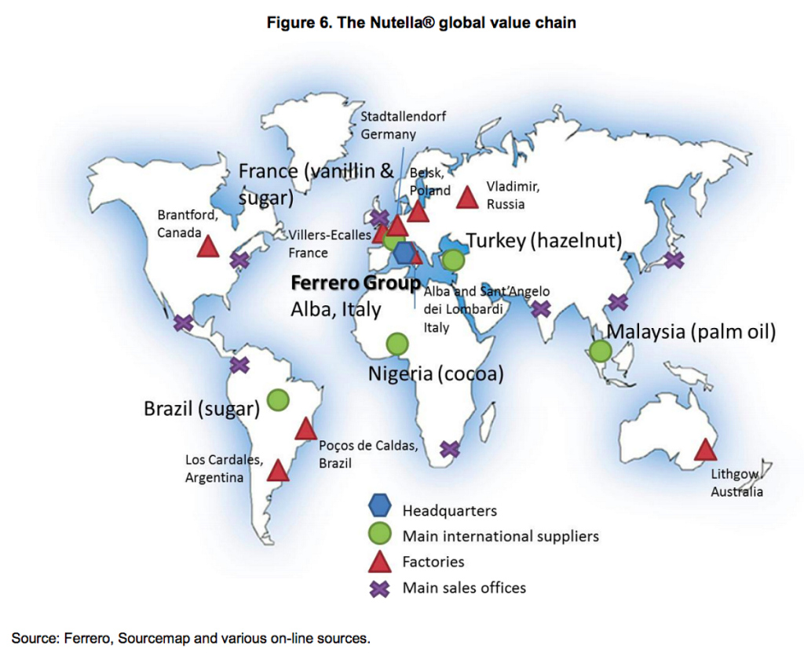
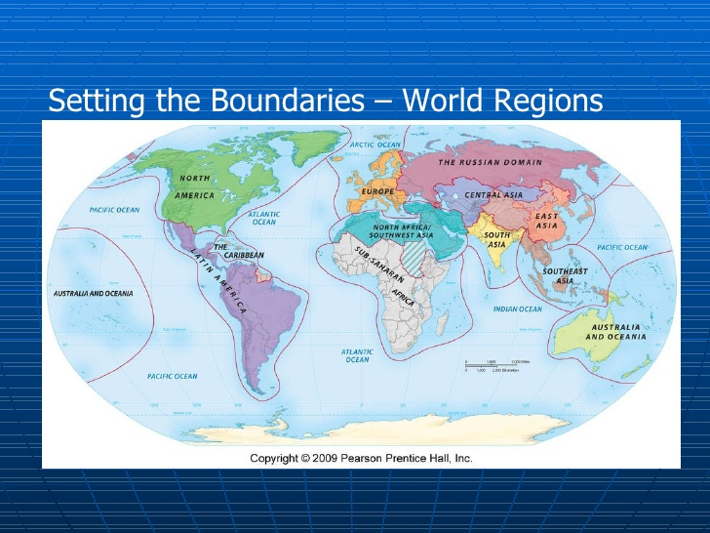
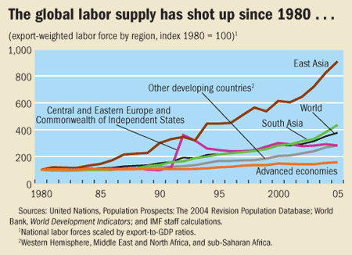
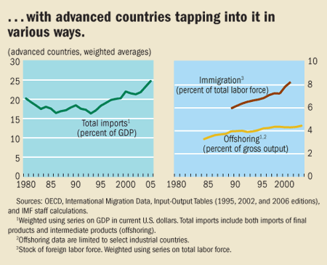
B. Taking advantage of the International Division of Labour
Document 1: Increasing Of Labor Forces In The World (International Monetary Fund)
Document 2: Several Means To Reduce Production Costs: Immigration And Offshoring (International Monetary Fund)

Slide 8
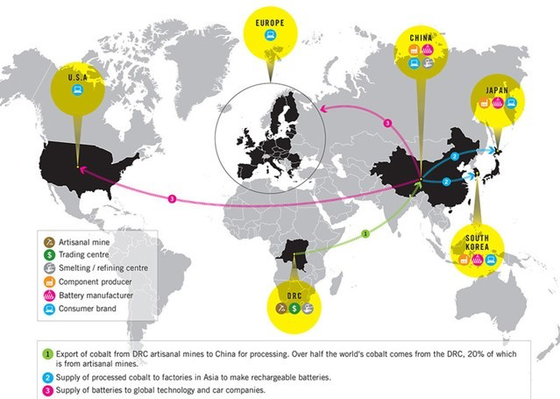
Movement of cobalt from DRC mines to the global market — via Amnesty International

Slide 9
C. Taking advantage of the competition between territories
Document 1: Monsanto and the development of the Third World, thanks to the Water Efficient Maize for Africa (WEMA)
The Water Efficient Maize for Africa project (WEMA) is a public/private partnership, led by the Kenyan-based African Agricultural Technology Foundation (AATF) and funded by the Bill and Melinda Gates Foundation, Howard G. Buffett Foundation, and USAID. It was created with a goal to enhance food security in Sub-Saharan Africa through developing and deploying drought-tolerant maize royalty-free to the smallholder farmers. Insect-protection is complementary to the efforts of developing more drought-tolerant maize varieties and will also be available royalty-free. This increased yield stability has the potential to help reduce hunger and improve the livelihood of millions of Africans. Monsanto contributions include providing maize germplasm to enable the breeding efforts, offering technical expertise to develop and deploy locally adapted maize hybrids, and donating its commercial drought-tolerance and insect-protection traits royalty-free to all seed companies in Africa.
“Improved Maize Varieties to Aid Farmers in Sub-Saharan Africa”, published on the Monsanto website
Document 2: Nokia’s globalized production and “positive impacts”
Nokia has production facilities located all over the world and we’re working to make each one as sustainable as possible. In part, this means minimising any negative environmental and social impact the facility may have - for example, by reducing its energy consumption or ensuring materials are ethically sourced. But it also means maximising the positive impact our presence can have on the local community - from providing rewarding employment opportunities to supporting worthy causes, such as schools or hospitals. […]
Leaner, greener operations in China – Beijing (establishment in 1995)
Responsible for smartphone and feature-rich phone production, our Beijing facility shows how good design can enhance sustainability. In 2000, we moved into the purpose-built XingWang industrial park, which clusters Nokia with several key suppliers. This helps reduce transportation costs, and offers significant savings on energy and emissions.
www.nokia.com

Slide 10
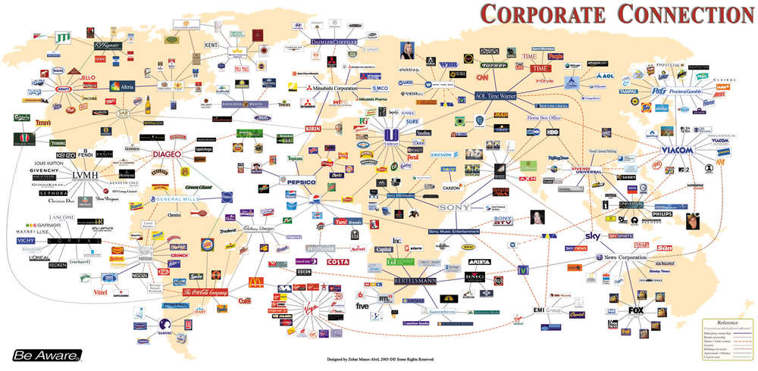

Slide 11
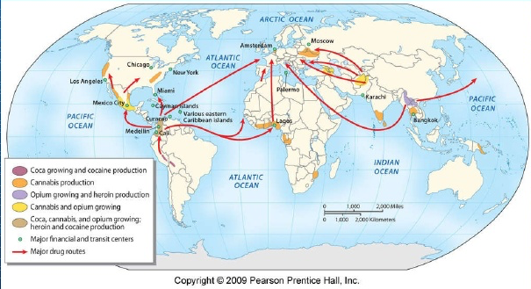
The dark side of globalization: organized criminal trade

Slide 12
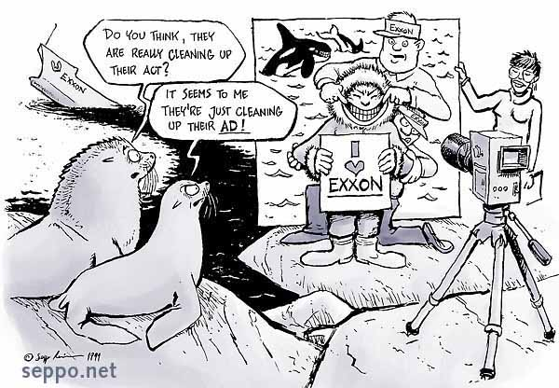
III. What limits to these territorial strategies ?
A. Environmental limits
Document 1: Exxon Valdez Oil Spill, 20th anniversary cartoon (2009)
Killer whale: orque
Bottling plant: usine d’embouteillage
Lead: plomb
Oil tanker: pétrolier
Seals : phoques (lying on a rock)
Sea ice : banquise
Sludge: boue, vase
Water table: nappe phréatique
Wince (to): faire la grimace
Document 2: Pollution Fine Sought Against Coca-Cola
A state government panel recommended Tuesday that Coca-Cola’s Indian subsidiary be fined $47 million for damage to the water and soil in a southern Indian village that it said had been caused by one of the company’s bottling plants. The plant, which opened in 2000 and closed five years later, polluted the groundwater and soil around the village of Plachimada, in the state of Kerala, the panel said. Coca-Cola said in a statement that it was unfortunate “that the committee in Kerala was appointed on the unproven assumption that damage was caused, and that it was caused by Hindustan Coca-Cola Beverages.” According to the panel, the bottling plant discharged a sludge that contained toxic chemicals like cadmium and lead. After villagers complained that the water table had dropped and farms were less productive, the village council decided not to renew the plant’s license.
Hari Kumar, The New York Times, March 23, 2010.

Slide 13
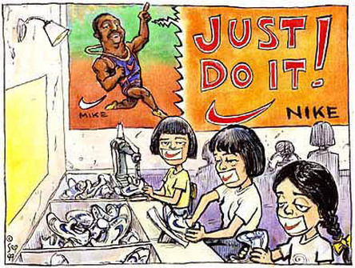
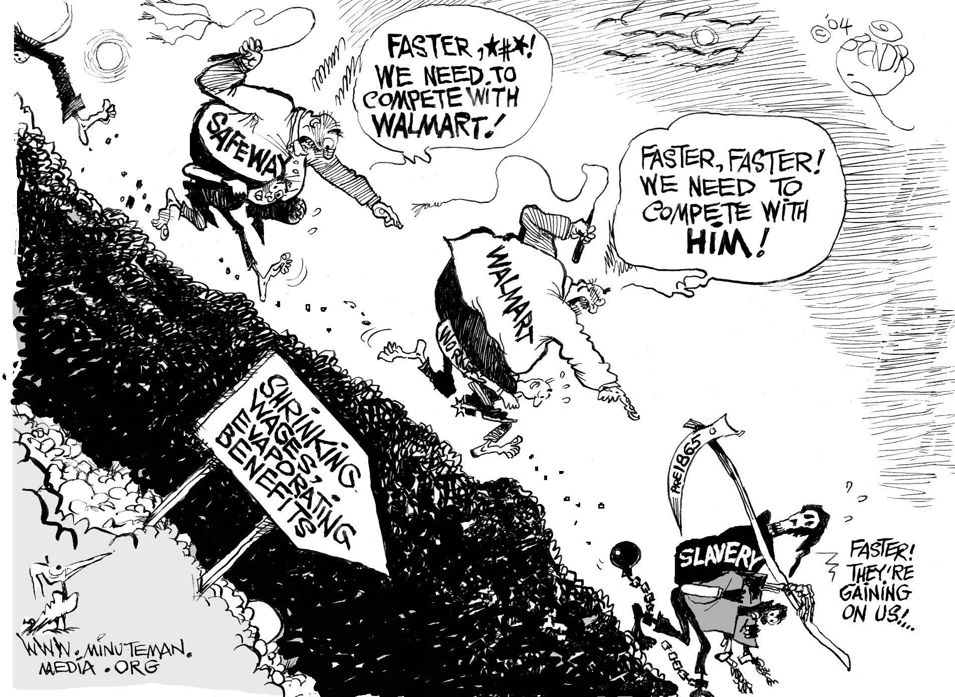
B. Critics and debates about globalization: how to reduce economic gaps ?
Document 1: Nike, “just do it!”, 1997 (www.tncandglobalisation.weebly.com)
Document 2: A dissident point of view (“Exploring the Global Race to the Bottom” - www.globalchange.umich.edu)
This culture of high-stress work, anxiety and humiliation contributes to widespread depression. Xu says there was another suicide a few months ago. (…)
In 2012, 150 workers gathered on a rooftop and threatened to jump. They were promised improvements and talked down by management; they had, essentially, wielded the threat of killing themselves as a bargaining tool. In 2016, a smaller group did it again. Just a month before we spoke, Xu says, seven or eight workers gathered on a rooftop and threatened to jump unless they were paid the wages they were due, which had apparently been withheld. Eventually, Xu says, Foxconn agreed to pay the wages and the workers were talked down.
« Life and death in Apple’s forbidden city », 18 june 2017, www.theguardian.com

Slide 14
