Slide 1

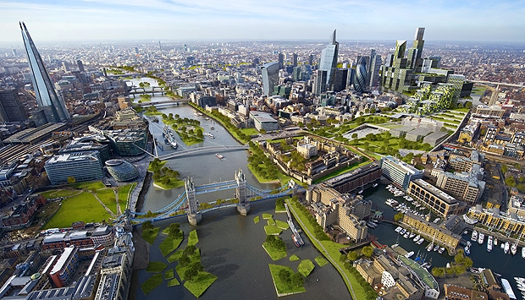
LIVING IN THE UK
DEVELOPPING BRITISH TERRITORIES

Slide 2
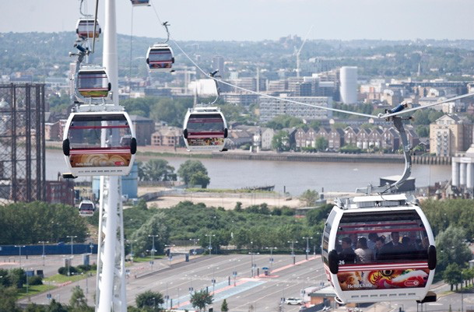
PLANNING AND MANAGING THE TERRITORIES IN THE UNITED KINGDOM: CHALLENGES AND ACTORS
The Emirates Airline offers spectacular views across London connecting Newham with Greenwich over the Thames.
TO WHAT EXTENT MANAGING AND DEVELOPPING THE BRITISH TERRITORIES IS NECESSARY TO LIVE IN THE UK?

Slide 3
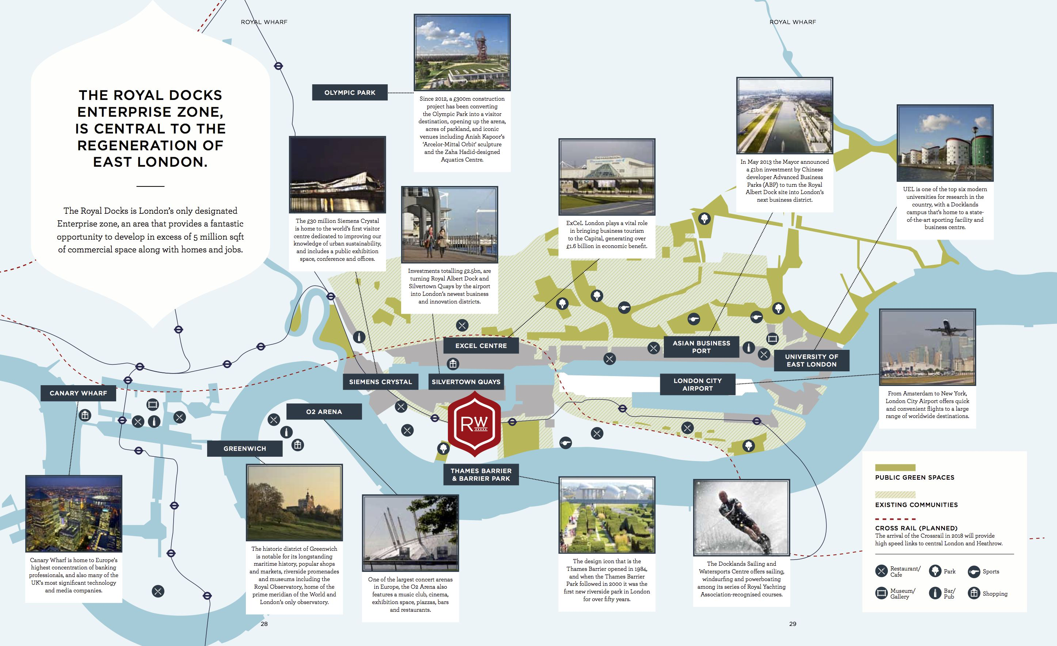
I. CITIES IN THE UNITED KINGDOM
A. Redevelopment areas in Greater London
￼
￼
￼

Slide 4
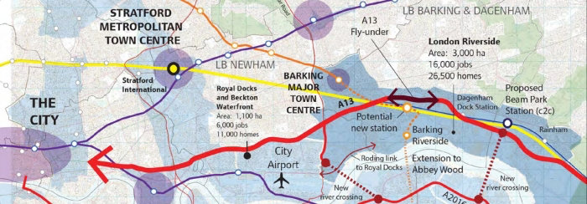
Rainham/London Riverside
The main focus of our activity going forward into the next year is in the Rainham residential area. Key to our long term vision is securing Housing Zone status to bring forward more than 3,000 new homes in a new garden suburb. We will establish a strong relationship with the developer on the old Somerfield and Dovers Corner sites and work with them on a phasing plan. We will complete a Grip 4 business case for the Beam Park station and produce a delivery plan for the station linked to housing development. Together with the GLA we will produce a programme of how the GLA is taking the Beam Park site forward and establish Havering as a strong influencer. In order to do this a key focus will be to create a business case and thereafter a Business Plan for Havering to invest to deliver homes in this area through a LBH Housing Development Company. Working with the London Riverside BID we will produce an investment plan to transform the economic vitality of that area, to attract and retain value added businesses.
www.havering.gov.uk

Slide 5
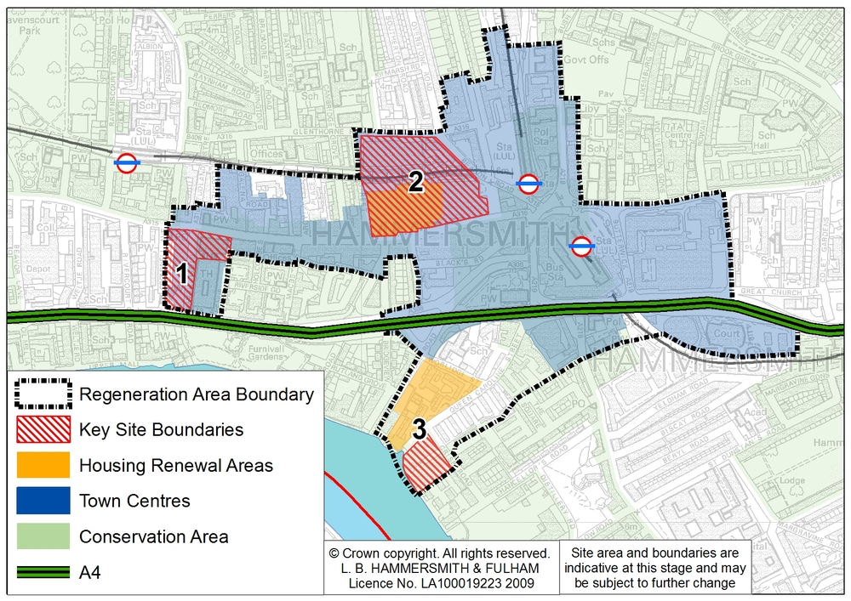
A BID is “a defined area within which the local business community invest together to improve the trading environment”. A levy (i.e. tax) is imposed on those local businesses and spent on local priorities identified by whichever consultancy firm was lucky enough to pick up the contract. The logic of the model is that what is good for business in an area is good for the people of an area. Those of us who believe that there is more to our lives than just consuming find ourselves at odds with national and local state policy, which backs BIDs regardless of the specific area, or the ‘priorities’ stated. The Lifford BID covers a lot of residential streets in contrast with for example the Colmore BID in town.(…) BIDs should be seen in the context of both cuts to local services and the privatisation of public space. Both of these aims form a part of a neo-liberal agenda. Whilst a ‘partnership agreement’ between council sevice providers and the BID company ‘benchmarks’ the services provided guaranteeing ‘additionality’, in our times when local authorities are only too happy to roll back services these benchmarks are inevitably going to be low. Furthermore, regardless of the level of, for instance, policing provided, having a private security contractor hired on behalf of local businesses to patrol a high street is inarguably privatisation.
BAN THE BID
By Chris Tomlinson, www.slaneystreet.com

Slide 6
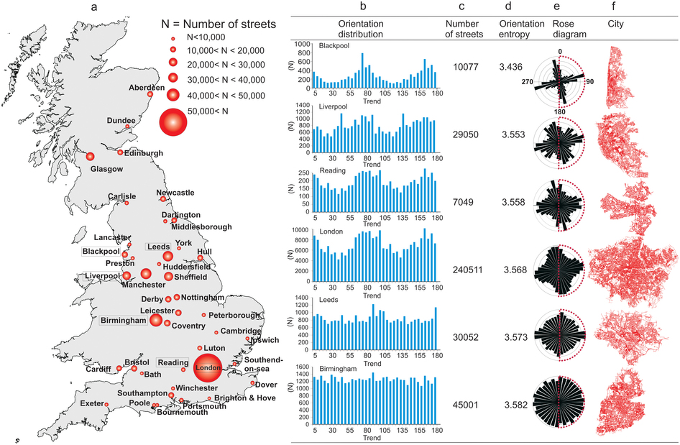
B. Developping and planning the UK urban network

Slide 7
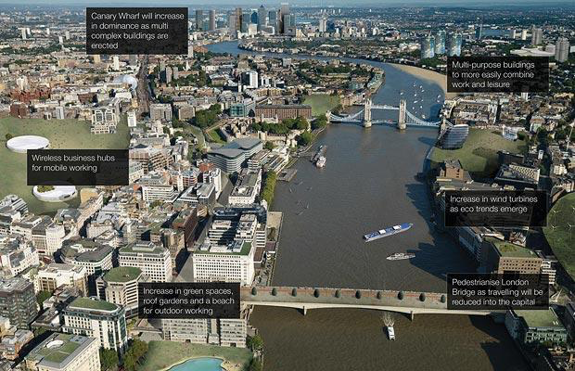
Office tower blocks will disappear from city skylines as the traditional nine-to-five grind dies out
London as Microsoft researchers imagine it could look in 2033. www.telegraph.co.uk
What is Britain’s smart cities about?
With the population of London growing at the rate of one full tube train every three days, we must deal with the significant implications of these changes on the planning for future transport systems, housing and services such as education and healthcare. Something about our approach to these challenges has to change, and quickly.
Coupled with this, disruptive technologies are shaking up traditional business processes faster than ever before. This, though, represents both a challenge and an opportunity. Collectively, we need to manage the rising tide of urbanisation and ensure that new and existing cities remain liveable while becoming more resilient and more sustainable. The only way we can make cities smarter is by harnessing disruptive technologies and business processes, unlocking new ways to fundamentally change how we deliver civic services and develop more efficient ways to design, build and run urban infrastructure.
So, the time has never been better for Telegraph Business Events to organise Britain's Smart Cities, a dive into the overarching challenges UK cities are facing; and how pioneering city leaders at home and abroad are embracing “smart city” concepts to drive economic development, better environmental outcomes and improved quality of life for citizens.
Dan Byles, 30 July 2015, www.telegraph.co.uk

Slide 8
C. Future cities: Glasgow prototype
An ambitious programme to open up Glasgow like never before
In 2013, Glasgow beat a host of other UK cities to win funding worth £24m from the Technology Strategy Board (now known as Innovate UK) to explore innovative ways to use technology and data to make life in the city safer, smarter and more sustainable. From our state-of-the-art city operations centre to the creation of an innovative city data hub, Glasgow is putting people at the heart of its future. Over the last 18 months, Glasgow has been developing a series of initiatives to showcase the exciting potential offered by smart city technology.
www.futurecity.glasgow.gov.uk

Slide 9
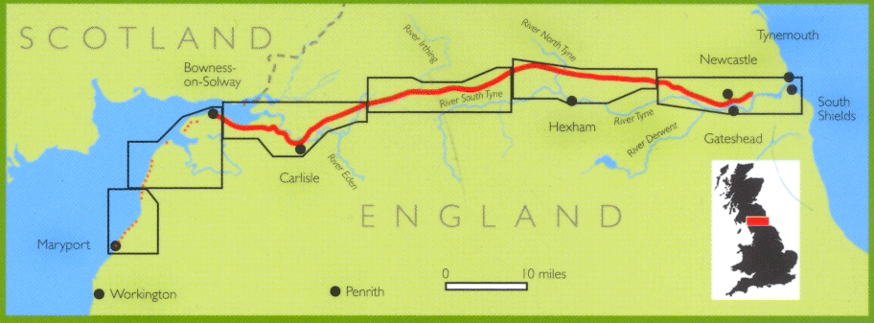
II. DEVELOPPING AND PROMOTING PERIPHERAL REGIONS
A. Promoting World Heritage sites in Scotland
Originally inscribed on the World Heritage List in 1987 as “Hadrian’s Wall”, the property was expanded in 2005 and 2008 to include the other ‘Roman Limes’ in Europe and now represents the outermost boundary of the Roman Empire at its zenith in the 2nd century AD. The focus of the restoration project is the 188-km-long Hadrian’s Wall (UK), built on the orders of Emperor Hadrian c. AD 122. The Wall, the greatest Roman defense line ever built, is a striking example of military organization and illustrates the geopolitical strategies of ancient Rome.
After taking detailed surveys in May, expert stone masons will begin the conservation work on the Wall in early summer, and the project is expected to be completed in August 2013. (…)
SITA Trust, an independent body established in 1997 by the Landfill Communities Fund, serves as a funding conduit for environmental and community building projects in the UK by allocating funds contributed by SITA UK, a large recycling and resource management company. To date SITA Trust has supported more than 3,000 projects for a combined total of over £87 million (US$ 137 million).
Frontiers of the Roman Empire World Heritage site receives funding to restore portions of Hadrian’s Wall, www.whc.unesco.org (20 april 2012)

Slide 10

B. Managing tourism heritage sites in Wales
As the 25th anniversary of the strike was marked in 2009, the NUM had just 4,000 members. Photograph: Zen Icknow/Corbis (The Guardian, Friday 16 September 2011)
What is a national park?
In the UK, national parks are areas of exceptional natural beauty which benefit from special protection and management, with great opportunities for everyone to enjoy the outdoors.
There are 14 national parks in the UK, three of which are in Wales: the Brecon Beacons, Snowdonia and the Pembrokeshire Coast.
The national park authorities are here to:
- Conserve and enhance the natural beauty, willdife and cultural heritage of the parks
- Promote understanding and enjoyment of their special qualities
- Foster the social and economic wellbeing of the communities within their boundaries
Dedicated teams look after the countryside and built environment in partnership with many others. But we all have a part to play in shaping the landscape by getting actively involved in protecting its special qualities and planning its future.
About the Brecon Beacons National Park Authority
The Brecon Beacons National Park Authority is a special purpose local authority operating within local government. With support from expert staff, its members are responsible for making decisions, setting policies and priorities and ensuring best use of resources. (…) Much of the Authority's work is carried out in partnership with other public bodies which also have a duty to take account of National Park purposes in their decisions

Slide 11

III. MOBILITY, FLOWS AND NETWORKS
A. London Heathrow airport: developping transports
Heathrow Hub is an integrated air, road and rail proposal which, in a cost effective way, would increase the number of Heathrow’s available aircraft slots. The innovative scheme, as proposed, involves extending one or both of Heathrow’s existing runways up to a total length of about 6,500 metres and dividing them so that they each provide two runways, each allowing simultaneous take-offs and landings. Heathrow Hub’s independent proposal to extend the northern runway at the airport has been shortlisted by the Airports Commission in its interim report. […]
Construction cost: One of the proposal’s key elements is that the capital cost and hence the airport user charges would be much lower than either of the other shortlisted option, therefore protecting the UK’s economic competitiveness. […] Crucially, the scheme should be mostly privately funded.
www.heathrowhub.com

Slide 12
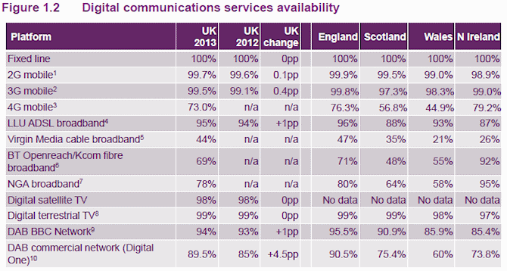
B. Developping communication networks
UK Superfast Broadband Coverage Hits 78% as Uptake Reaches 26.7%. Mark Jackson, 7 August, 2014, www.ispreview.co.uk
Investment and innovation
UK consumers and businesses have benefited from significant investment in communications services in recent years. 4G mobile broadband is now available to 42% of premises from all four operators, and 90% from at least one. Superfast broadband is now available to 83% of premises, with a range of providers competing on service and price.
Ofcom wants to see the widest possible availability of high-speed broadband at home, at work and on the move. Ofcom estimates that a broadband speed of 10Mbit/s is necessary to benefit from today’s popular online services, such as on-demand video. However, 8% of UK households cannot currently access those speeds.
Availability is a concern in more rural areas, particularly in the nations and regions,1 but also in some urban places where roll-out costs or low incomes present particular barriers. Ofcom’s review will seek possible solutions to these problems.
It is examining how regulation can enable the commercial development of future ultrafast broadband, making it as widely available as possible.2
Ofcom is also considering what further options might be available to improve mobile services. Mobile 4G broadband will reach 98% of UK premises, due to Ofcom rules and industry investment. But consumers’ and businesses’ growing expectations for reliable, universal, always-on voice and data services will need to be matched by network investment.
16 July 2015, www.media.ofcom.org.uk

Slide 13

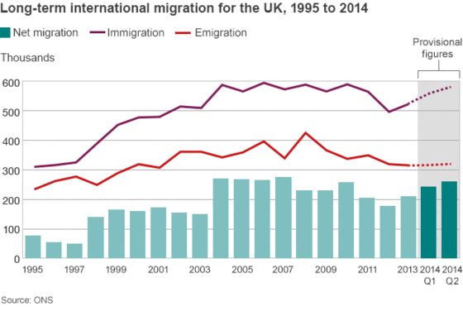
C. Increasing migratory flows: tourists, students, workers
www.bbc.co.uk
Between January and April the UK welcomed more than 10 million visitors for the first time ever, capping a successful 12-month period (April 2014 to April 2015) that saw 34.6 million tourists flock to the country. In April alone, it had 3.14 million visitors, which is a six per cent rise on the same month last year. The new figures, from the Office for National Statistics International Passenger Survey, show that financially April had a growth of one per cent, with a total of £1.5bn spent across Britain. Mark Di-Toro at VisitBritain said: 'International tourism is a highly competitive tourism environment, it's very promising to see a considerable return to growth as we approach the peak summer months.
'However, we do expect 2015 and 2016 to be more challenging for inbound tourism as the Euro weakens making it even more important to get our value message across to potential European visitors. (…) In 2014, Edinburgh was the most popular city with international visitors after London, followed by Manchester and Birmingham, with attractions such as Manchester's Museum of Science and the Birmingham Library continuing to draw in visitors. But Bristol, Liverpool, Oxford and Glasgow also fared well, proving the whole of the UK has something to offer international tourists.
« Cool Britannia! Record year for international tourism as Britain welcomes more than 34 MILLION foreign visitors », E. Payne, 12 June 2015 www.dailymail.co.uk

Slide 14
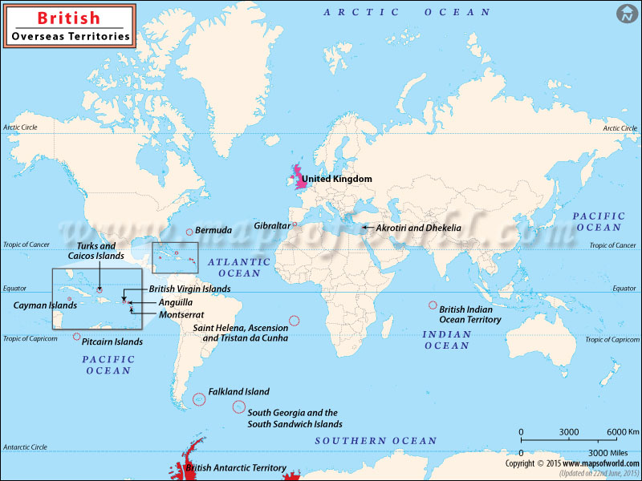
British Overseas Countries and Territories as an opportunity to be open to the world

Slide 15
