Slide 1

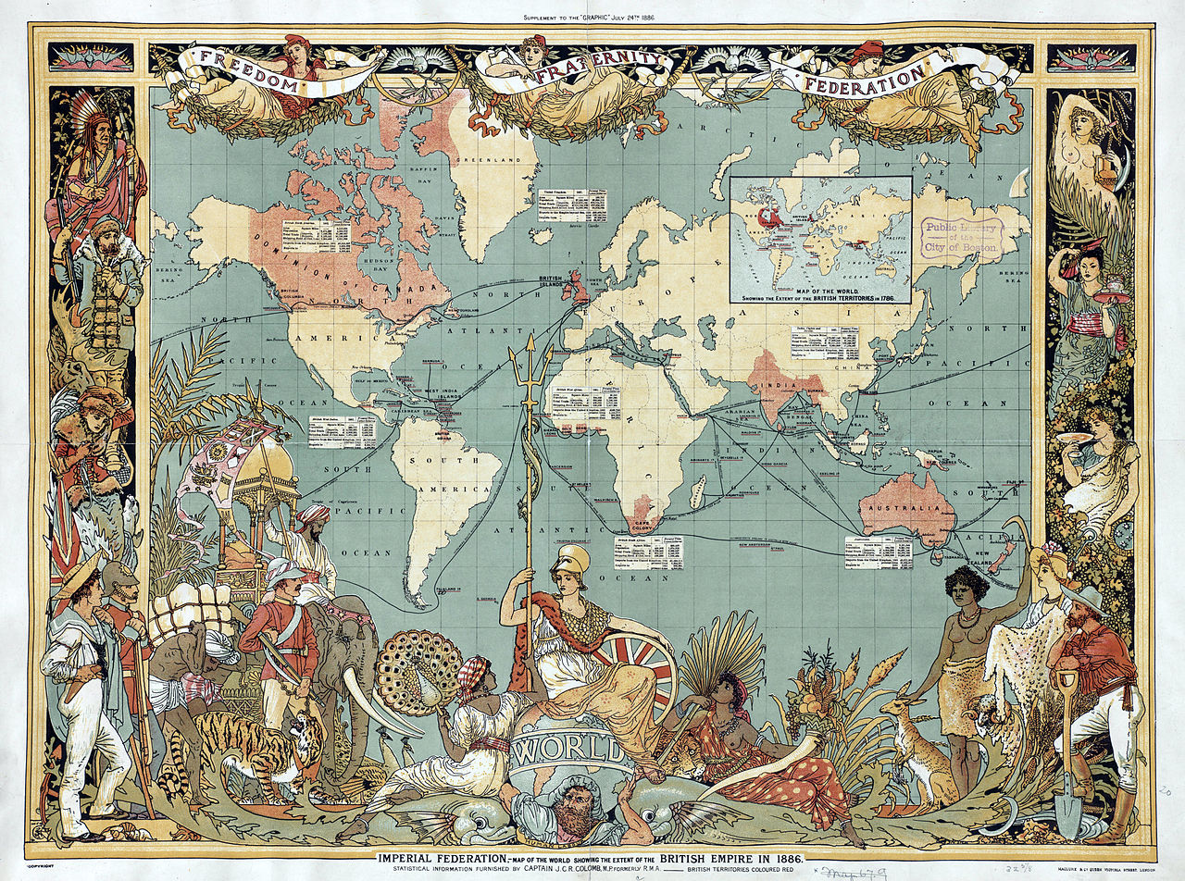
19th CENTURY EUROPE UNDER BRITISH RULE

Slide 2

TO WHAT EXTENT CAN WE CONSIDER THAT THE UK HAS BEEN DOMINATING EUROPE DURING THE SECOND PART OF THE 19th CENTURY?

Slide 3
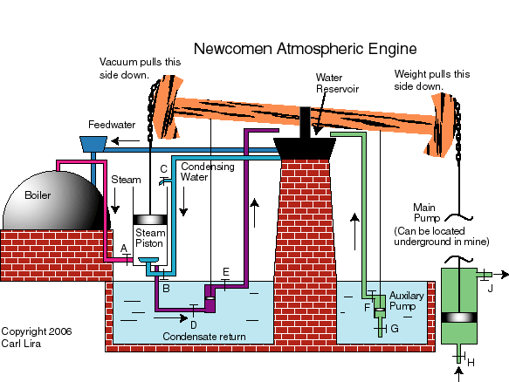
I. THE CRADLE OF THE INDUSTRIAL REVOLUTION
A. Origins of the industrialization process
"Nobody purposely invented industrial specialization with all its advantages for wealth creation. Rather, specialization evolved gradually – as a by-product of the natural human propensity to truck, barter and exchange one thing for another.
The precise nature of that propensity and its connection to our faculties of reason and speech is beyond the scope of the present enquiry. Here, I simply note that the propensity is common to all human beings and that it is unique to humanity. »
Adam Smith, The Wealth of Nations: A Translation into Modern English, ISR/Google Books, page 10

Slide 4
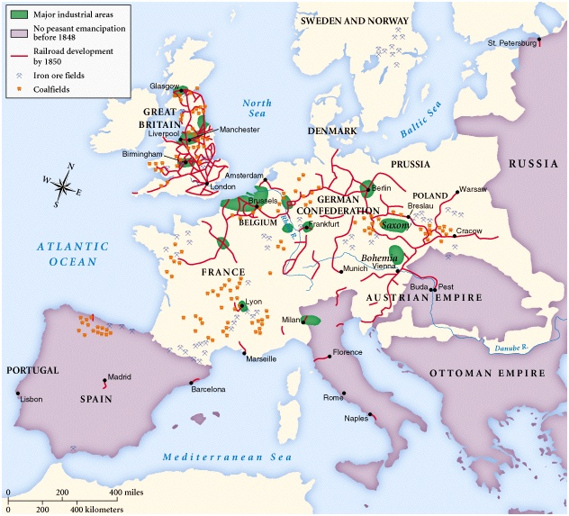
B. The first industrialized country in the world

Slide 5
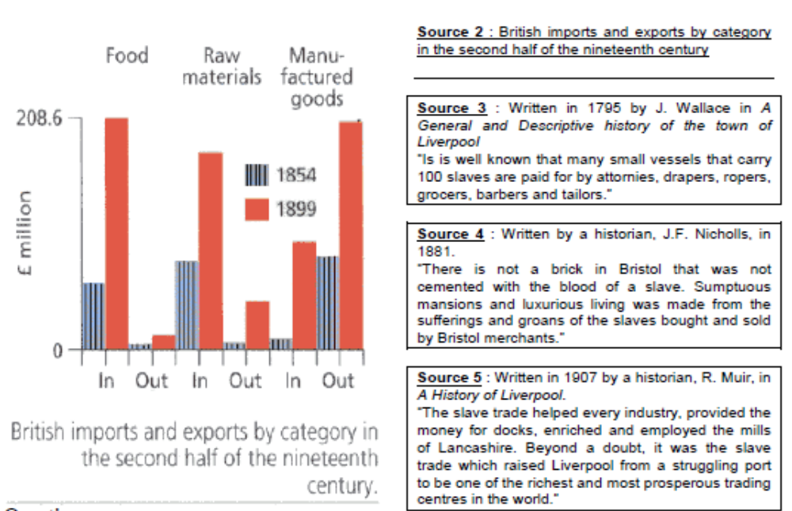
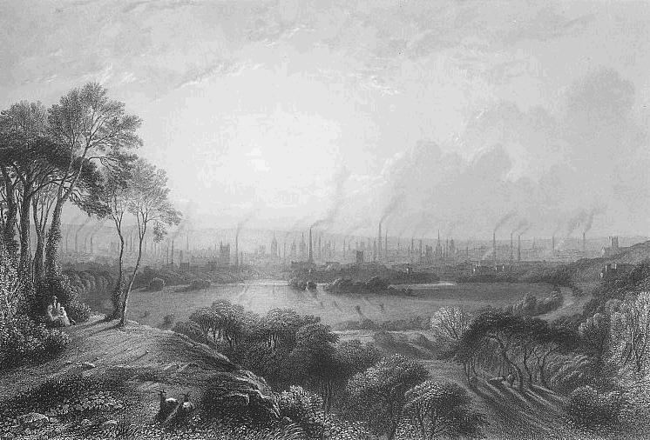
C. Economic and political consequences
“Cottonopolis”, engraving by Edward Goodall (Manchester, 1840)

Slide 6
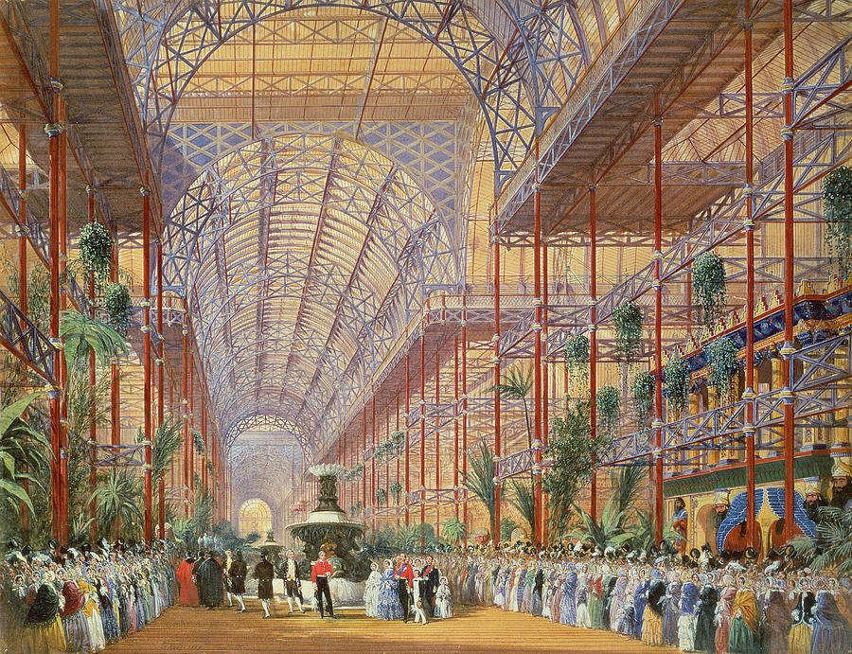
II. CHARACTERISTICS OF THE VICTORIAN AGE
A. Queen Victoria: a very modern stateswoman, loving arts and sciences
Queen Victoria Opening The 1862 Exhibition After Crystal Palace Moved To Sydenham, by Joseph Nash

Slide 7
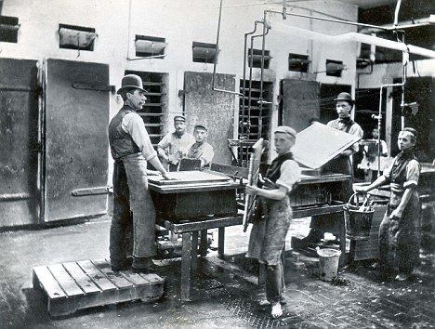
B. Increasing poverty: Dickens’ Britain
Photograph of match makers at the end of the 19th century: children involved in this process often suffered a horrible disease from breathing phosphorous. (Daily Mail, 17 September 2010)
- After introducing the two documents, describe and explain the manifestation of poverty in England.
- Explain the causes and consequences of poverty and pauperism in Britain.
A chronic condition of misery
It will be readily apparent to the reader that I saw much that was bad. Yet it must not be forgotten that the time of which I write was considered "good times" in England. The starvation and lack of shelter I encountered constituted a chronic condition of misery which is never wiped out, even in the periods of greatest prosperity. […]
Society grows, while political machines rack to pieces and become "scrap." For the English, so far as manhood and womanhood and health and happiness go, I see a broad and smiling future. But for a great deal of the political machinery, which at present mismanages for them, I see nothing else than the scrap heap.
Jack London, The People of the Abyss, Preface, 1903.
Notes:
- After introducing the two documents, describe and explain the manifestation of poverty in England.
- Explain the causes and consequences of poverty and pauperism in Britain.

Slide 8
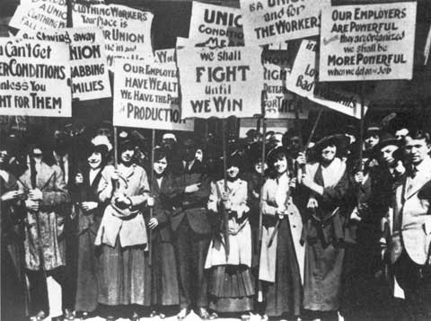
C. Increasing contests: birth of Socialism and Labor Movement
A Socialist point of view on the Victorian age
Before the uprising of modern Socialism almost all intelligent people either were, or professed themselves to be, quite contented with the civilization of this century. Again, almost all of these really were thus contented, and saw nothing to do but to perfect the said civilization by getting rid of a few ridiculous survivals of the barbarous ages. To be short, this was the Whig frame of mind, natural to the modern prosperous middle-class men, who, in fact, as far as mechanical progress is concerned, have nothing to ask for, if only Socialism would leave them alone to enjoy their plentiful style. […]
Apart from the desire to produce beautiful things, the leading passion of my life has been and is hatred of modern civilization. What shall I say of it now, when the words are put into my mouth, my hope of its destruction—what shall I say of its supplanting by Socialism?
William Morris, “How I became a Socialist”, Justice, June 16th, 1894.

Slide 9
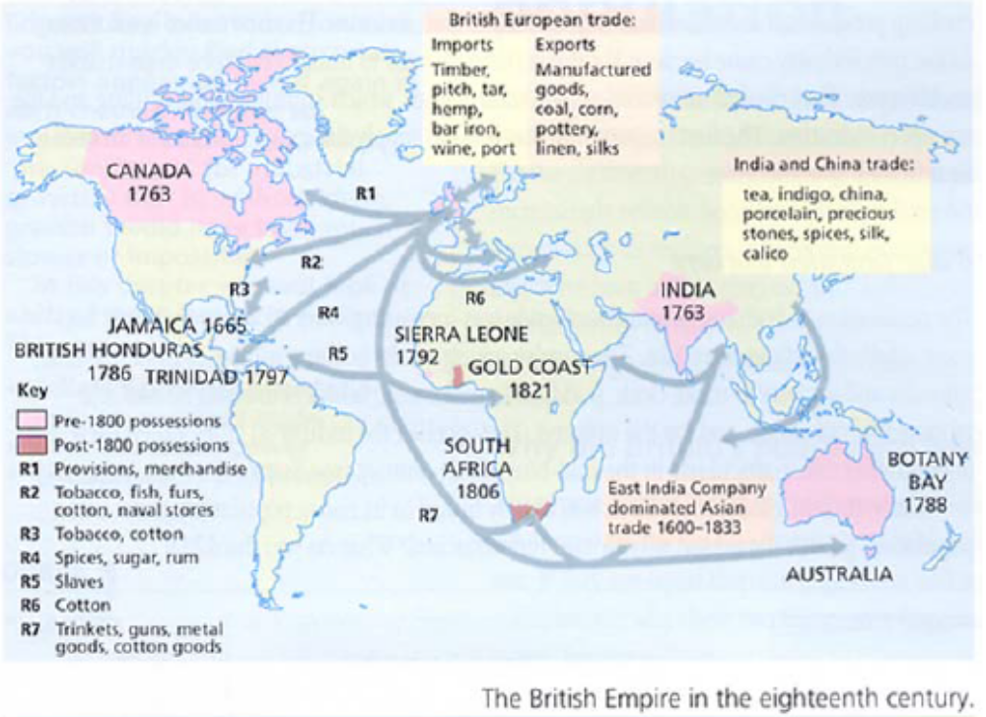
III. THE BRITISH IMPERIALISM
A. British conquests in the world: India, Burma and Africa

Slide 10
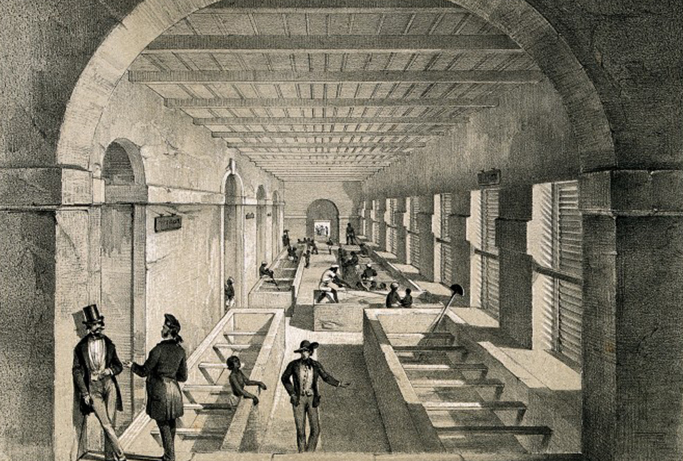
B. British exploitation of territories: exports and trade in Asia
“The Mixing Room, Opium Factory at Patna India”
“In the Mixing Room the contents of the earthen pans are thrown into vats and stirred with blind rakes until the whole mass becomes a homogeneous paste.”
Prose from The Graphic reproduced in: The Truth about Opium Smoking, 1882
Lithograph after W. S. Sherwill, ca. 1850
India ceased to be a leading manufacturing country of the precapitalist era and was reduced to the position of a supplier of agricultural goods and raw materials to the industrializing economies of the West, particularly Britain. The long process of deindustrialization of India started with the catastrophic disappearance of cotton manufactures from the list of exports of India… For more than seventy-five years up to 1913, India remained the major importer of cotton goods from Britain, often taking more than forty percent of the British exports… Other rural or urban manufactures were ruined partly by the rise of alternative sources of supply and by government restrictions.
(Bagchi 1984:82) – quoted in The Process of Economic Development, by James M. Cypher, 2014.

Slide 11
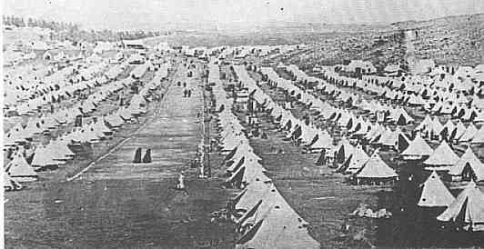
C. Increasing revolts against British oppression: concentration camps during Boer wars
The British moved civilians to civilians into concentration camps to prevent them from aiding Afrikaan guerillas, and set up block houses to prevent the movement of guerillas. Over 26,000 died in concentration camps.
Concentration camps were established by the British in South Africa (…). In both black and white camps many died from disease, due in part to insanitary conditions and overcrowding. The Liberal politician Sir Henry Campbell-Bannerman openly condemned what he called « methods of barbarism ». It has been estimated that between 20,000 and 28,000 white civilians died of disease in these camps. There were also 14,154 recorded deaths of black people from disease in the camps (…). One contemporary critic even used the term « holocaust » (…).
In June 1901, the campaigner Emily Hobhouse published her Report of a Visit to the Camps of Women and Children in the Cape and Orange River Colonies. In it she condemned the camp system as 'wholesale cruelty. It can never be wiped out of the memories of the people. It presses hardest on the children.' In Parliament, the policy was attacked by Liberal MPs, such as David Lloyd George and C.P. Scott. It was they who first used the term 'concentration camps', after the reconcentrado camps used by the Spanish against Cuban guerillas at the end of the 19th century. (Such camps were also used by the United States in the Philippines between 1900 and 1906). War Office officials preferred to call them refugee camps.
www.nationalarchives.gov.uk

Slide 12
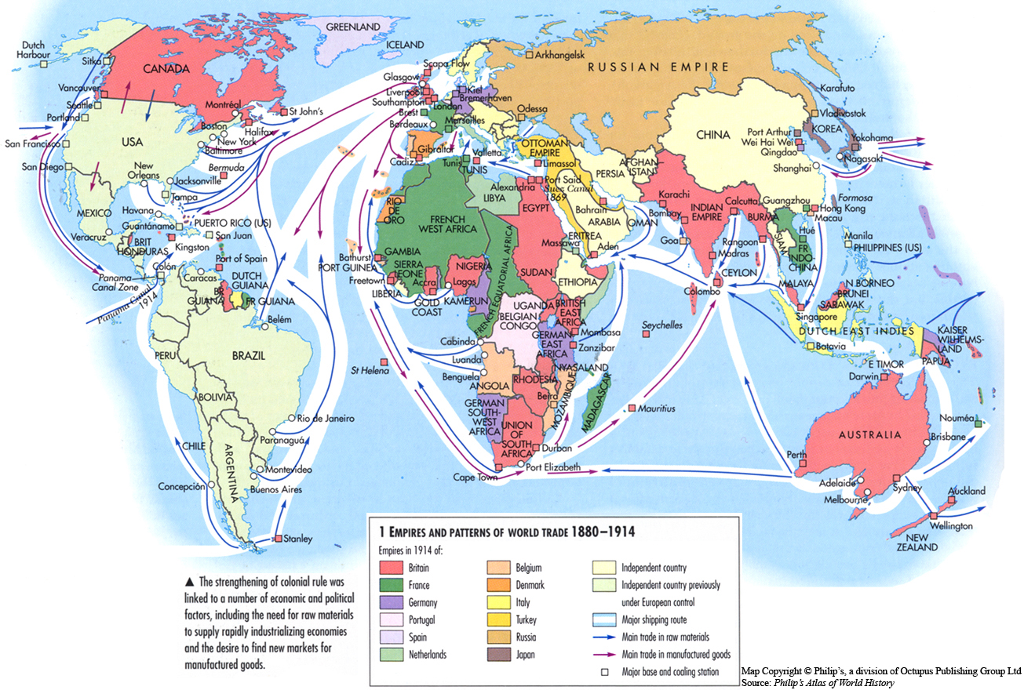
BIRTH OF A NEW WORLD ORDER IN THE 20th CENTURY

